Slide 1
Modelling customisation and implementation report
Fred F. Hattermann et al., Potsdam Institute for Climate Impact Research

Slide 2
Outline
Outline
Introduction
Fast-track information on climate change and impacts streamlined to the demonstrators
Advanced climate scenario data and bio-physical modelling implementation
Web portal for data and information
Conclusions and outlook

Slide 3
Objectives
Research aims and questions of this deliverable (D2.2)
To provide information on climate change and climate change impacts on bio-physical indicators streamlined to demonstrators of TransformAr
To upscale impacts and possible adaptation measures to the EU scale with high-resolution
Main partners: CMCC, ACTERRA, NCSRD, Demonstrators

Slide 4
However, in the course of the project, it turned out that the demonstrators had a demand for climate scenario and climate impact information from the start, while the deliverable D2.2 is due in month 36.
Also, it became obvious that the partners and end users had problems to understand the nature, underlying assumptions and amount of data available for them, although support was granted by PIK, CMCC and other involved partners. The data availability and description were also a demand from the midterm review.
The updated objectives of Deliverable 2.2 are therefore:
To provide climate and climate change impacts on bio-physical quantities streamlined to demonstrators throughout the project from its early phases (feeds into D2.1)
To support demonstrators in their workshops and products with information and presentations on climate change risks and related impacts in their region
To upscale impacts and to support design of possible adaptation measures to the EU scale with high resolution
To visualize and make available the data and information via an easy to use web portal

Slide 5
Outline
Outline
Introduction
Fast-track information on climate change and impacts streamlined to the demonstrators
Advanced climate scenario data and bio-physical modelling implementation
Web portal for data and information
Conclusions and outlook

Slide 6
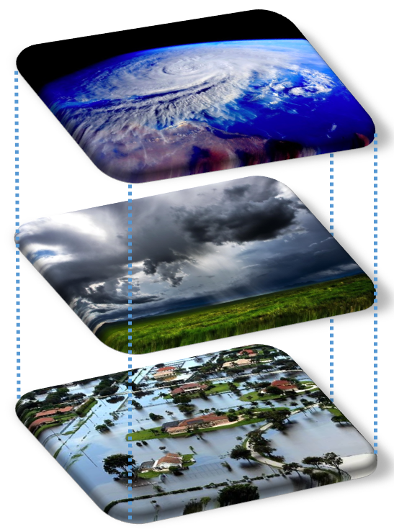
Model approach fast track
3 scenarios (low end, medium and high end warming) with 10 global climate model outputs each of the latest scenario generation (CMIP6)
The data were statistically downscaled and bias adjusted within the ISIMIP project
An eco-hydrological model was applied to translate the climate scenario data into change in water resources and extremes

Slide 7
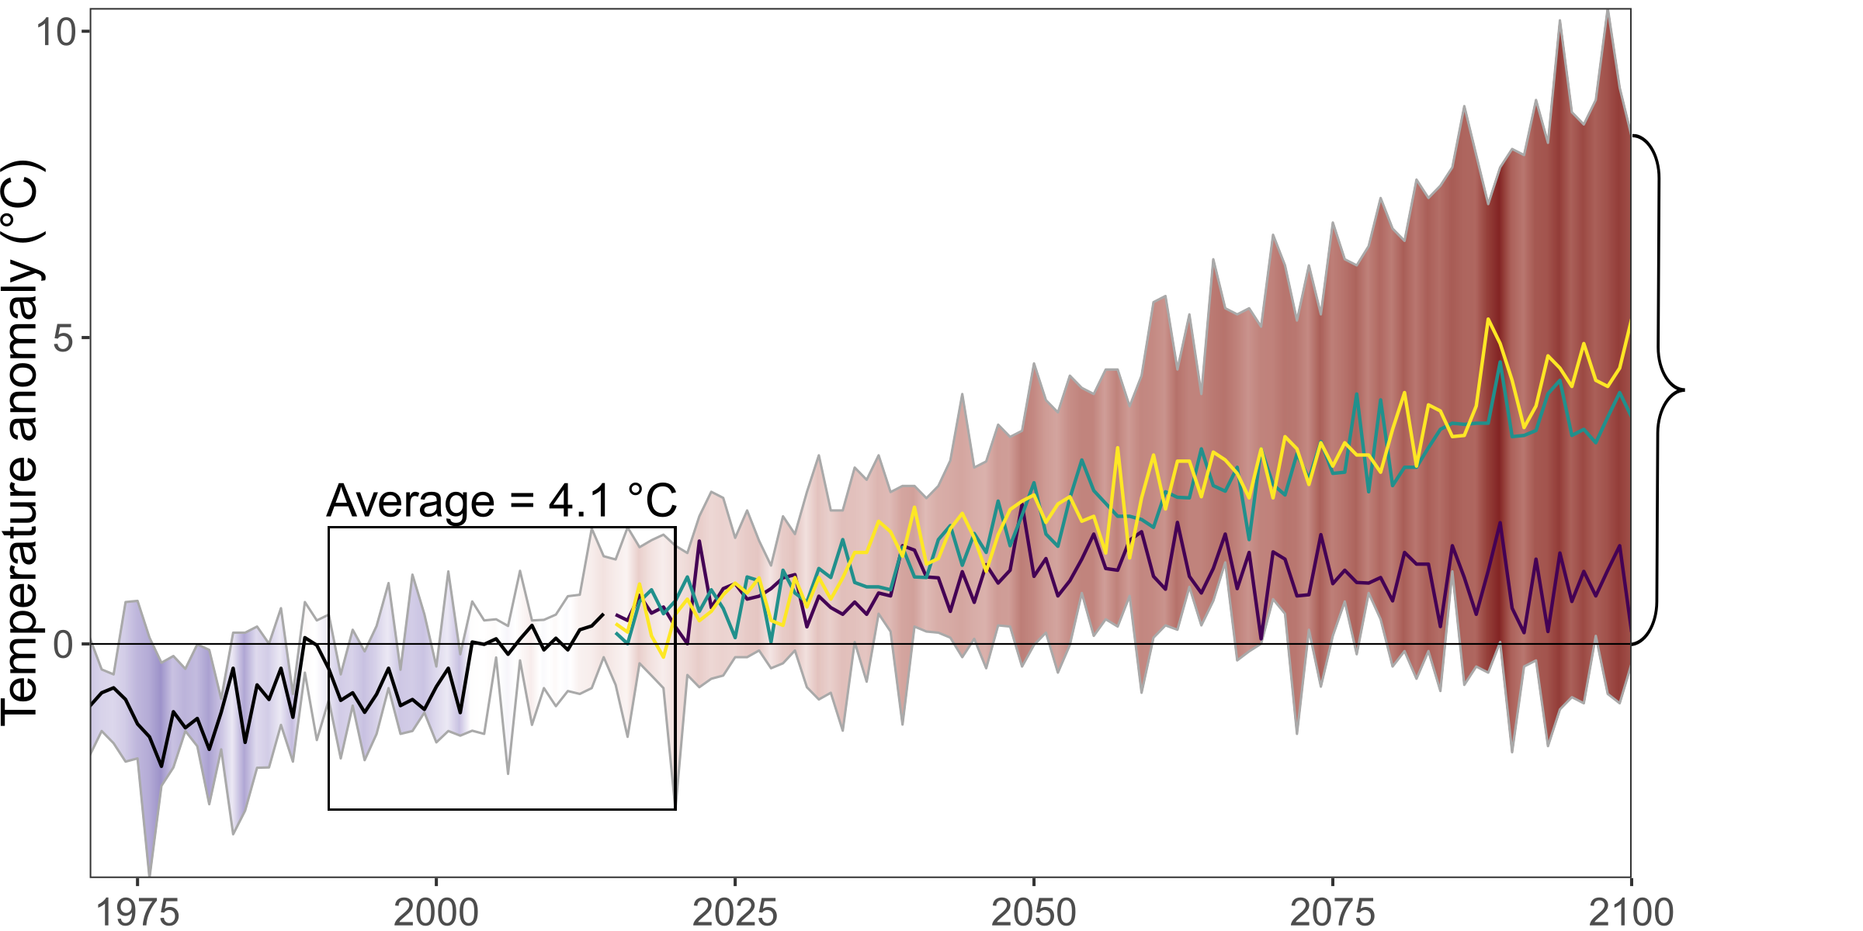

Temperature Projections – Example of Gjovic
Workshop II: Gjovik – Climate vulnerability, Impacts and Projections
Temperature
Emission scenarios
Possibly very strong temperature increase over 21st century relative to current conditions.
Increase depends much on the emission scenario → Time for action!
Climate Models
x
Emission scenarios
cold
warm
Data: ISIMIP 3b
Notes:
Data: https://www.isimip.org/ Phase 3b based on 5 Global Circulation Models (GCMs) of the CMIP 6 family which were used for the latest IPCC report (AR6).
3 emission scenarios (as used in latest IPCC report, AR6):
- Purple line: SSP 1 RCP 2.6 (optimistic)
- Green: SSP 3 RCP 7.0 (business as usual)
- Yellow: SSP 5 RCP 8.5 (pessimistic)

Slide 8
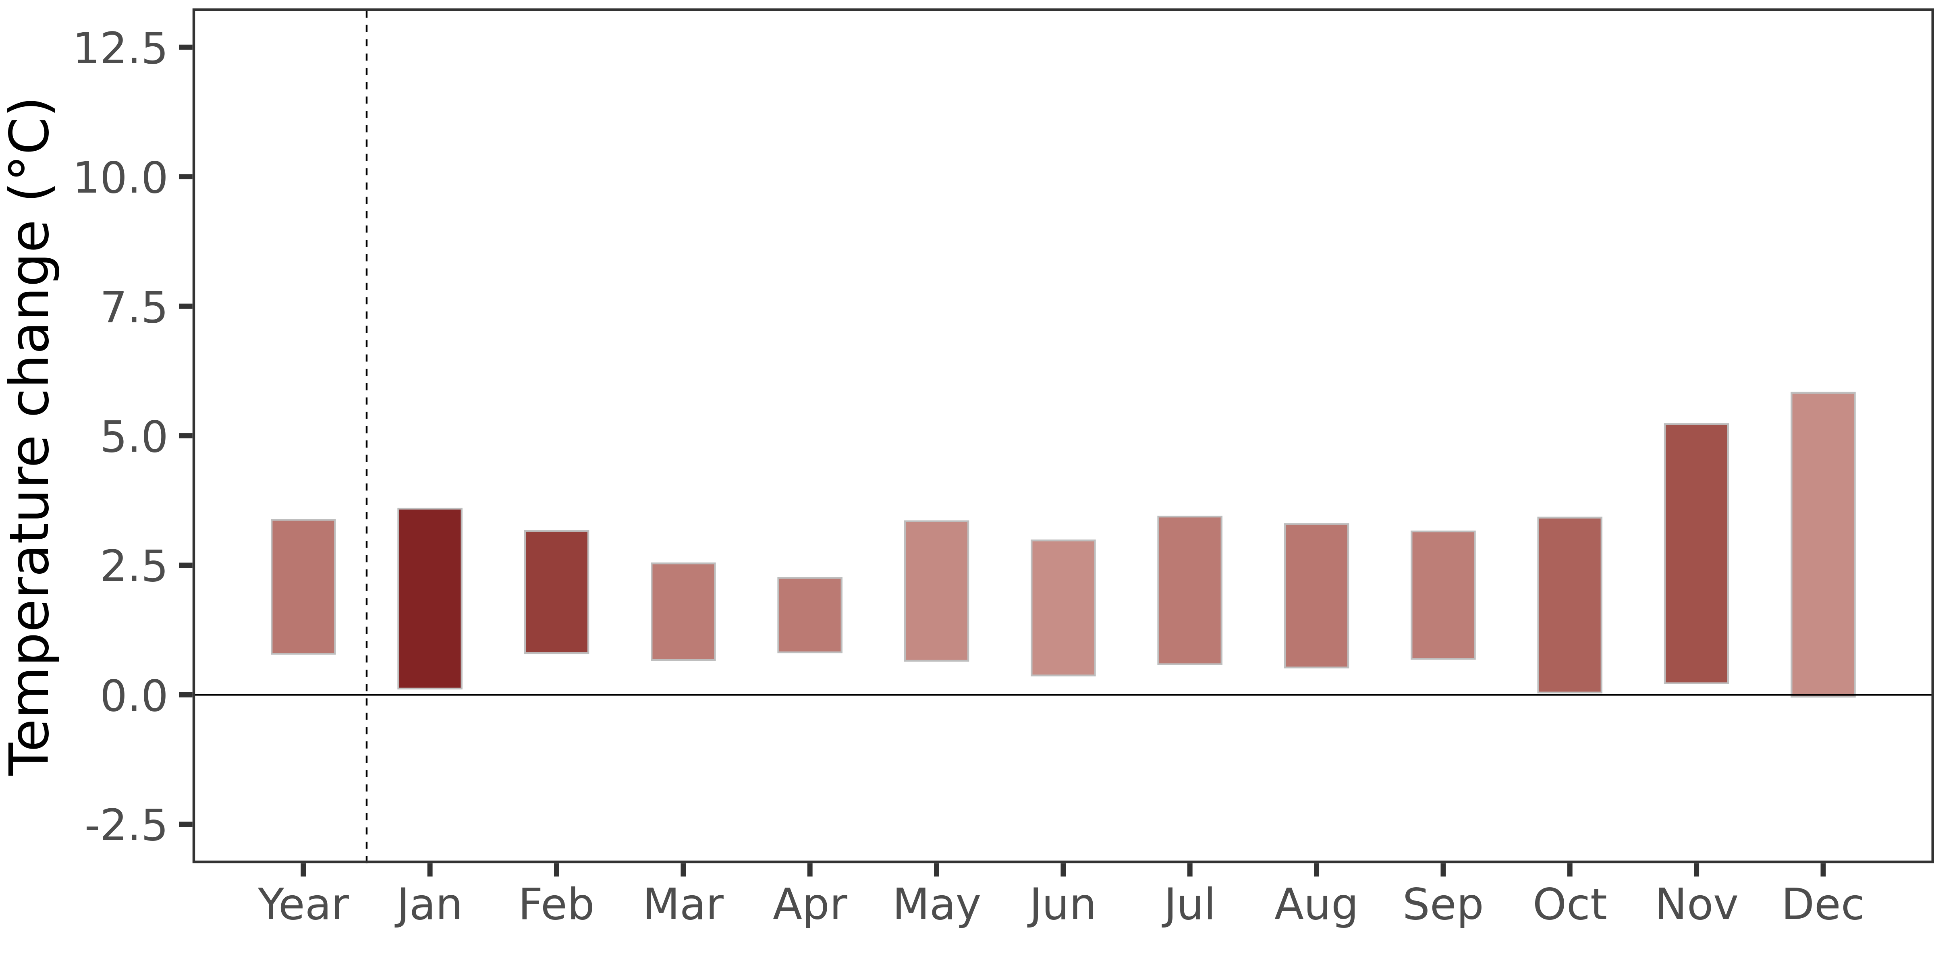
Temperature Projections – Example of Gjovic
Workshop II: Gjovik – Climate vulnerability, Impacts and Projections
Temperature (2031-2060)
Emission scenarios
Climate Models
x
Emission scenarios
Near future: + 1.5 °C.
Temperature increase stronger in winter (+ 2.3 °C in Jan) than in summer (+ 1.5 °C in Aug) here as well.
Climate Models
x
Emission scenarios
cold
warm
Data: ISIMIP 3b

Slide 9
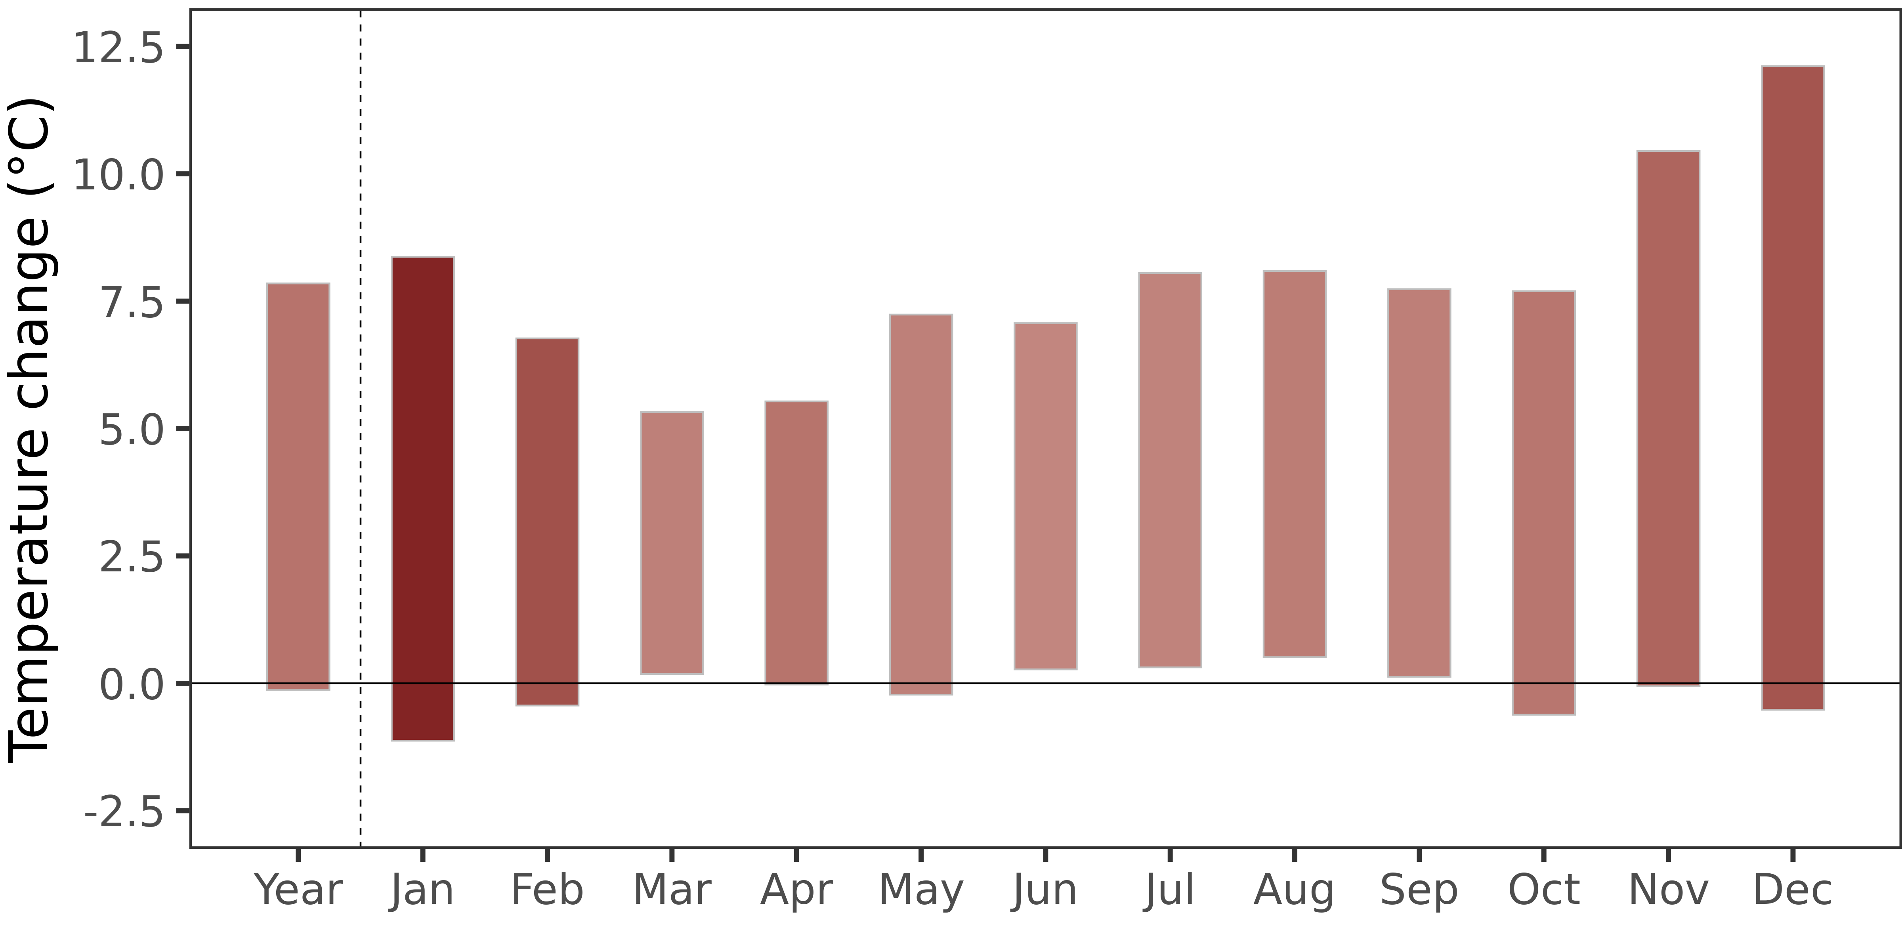
Temperature Projections – Example of Gjovic
Workshop II: Gjovik – Climate vulnerability, Impacts and Projections
Temperature (2071-2100)
Emission scenarios
Climate Models
x
Emission scenarios
Far Future: + 2.7 °C
A high increase in winter temperature (+ 4.2 °C in Jan)
In summer the rise in temperature about + 2.4 °C
Uncertainty is also higher than previous time slices.
Climate Models
x
Emission scenarios
cold
warm
Data: ISIMIP 3b

Slide 10
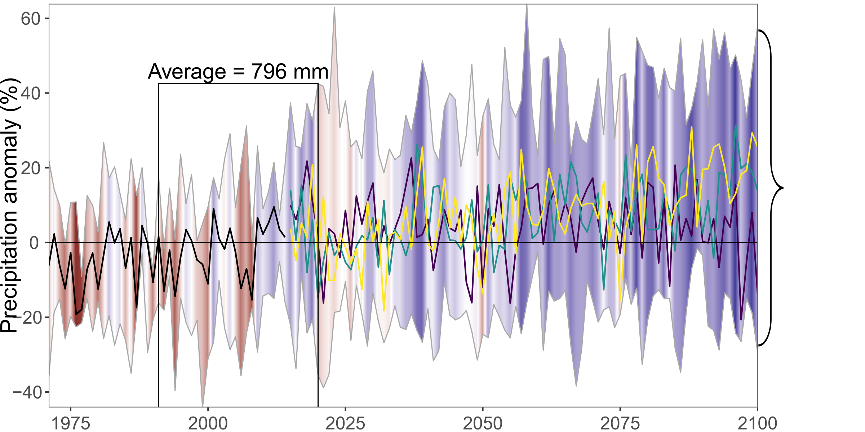
Precipitation Projections – Example of Gjovic
Workshop II: Gjovik – Climate vulnerability, Impacts and Projections
Precipitation
Emission scenarios
Climate Models
x
Emission scenarios
Increase in rainfall projections.
wet
dry
Data: ISIMIP 3b

Slide 11
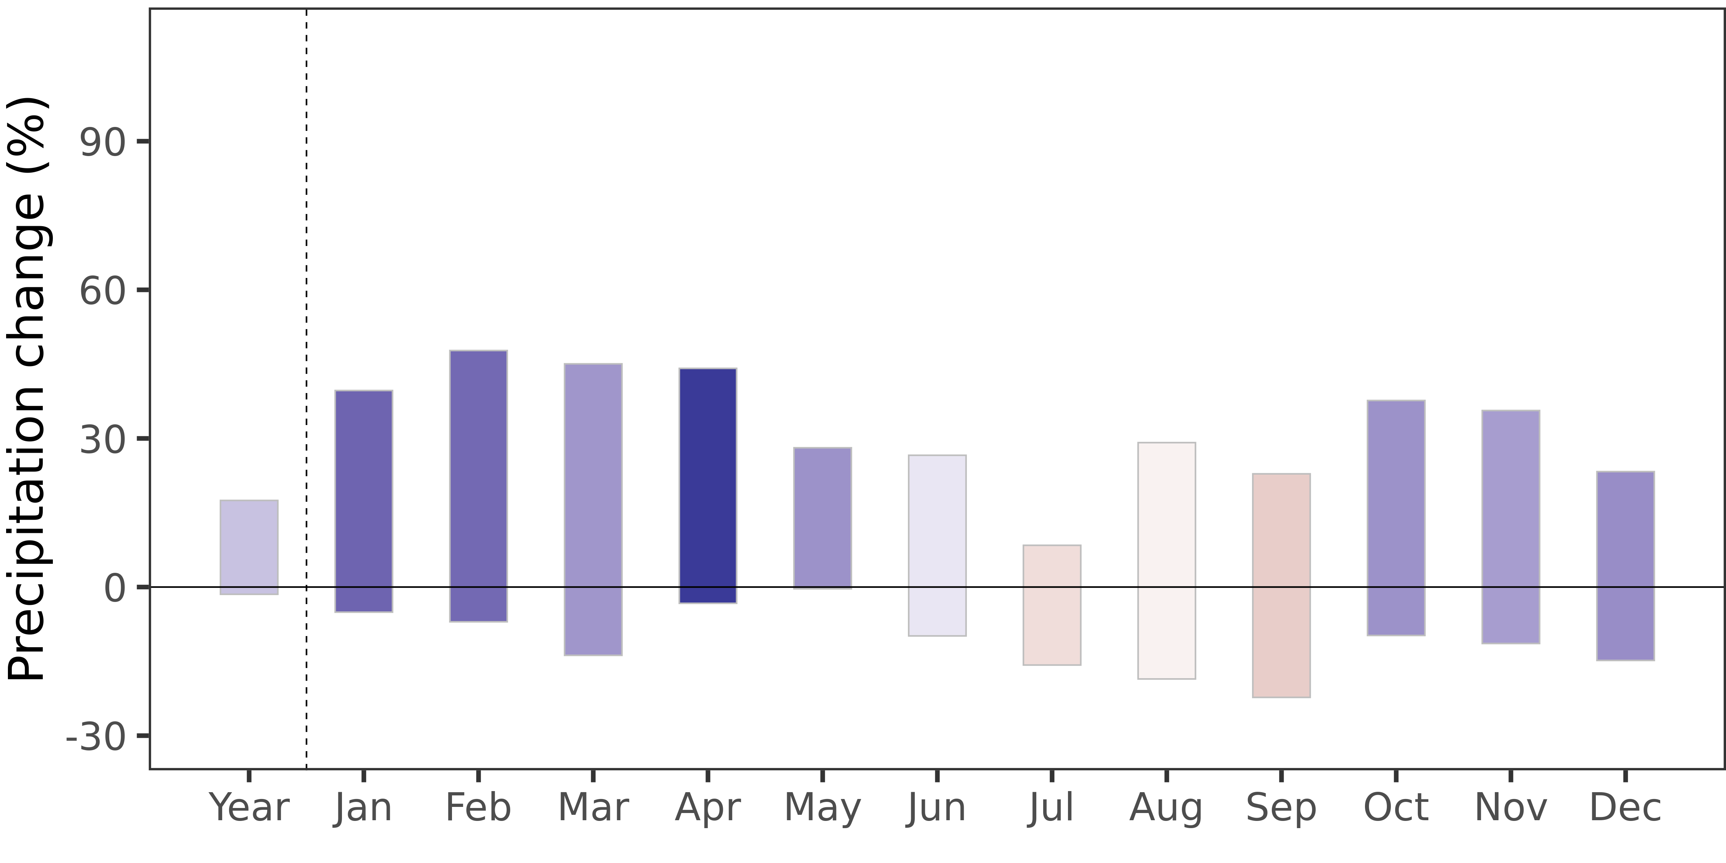
Precipitation Projections – Example of Gjovic
Workshop II: Gjovik – Climate vulnerability, Impacts and Projections
Precipitation (2031-2060)
Emission scenarios
Climate Models
x
Emission scenarios
Near future:
Strong increase in winter and spring rainfall (+ 7.6 % in Jan and 16.5% in Apr).
Decline in summer rainfall ~-2.9% in Jul
Climate Models
x
Emission scenarios
wet
dry
Data: ISIMIP 3b

Slide 12
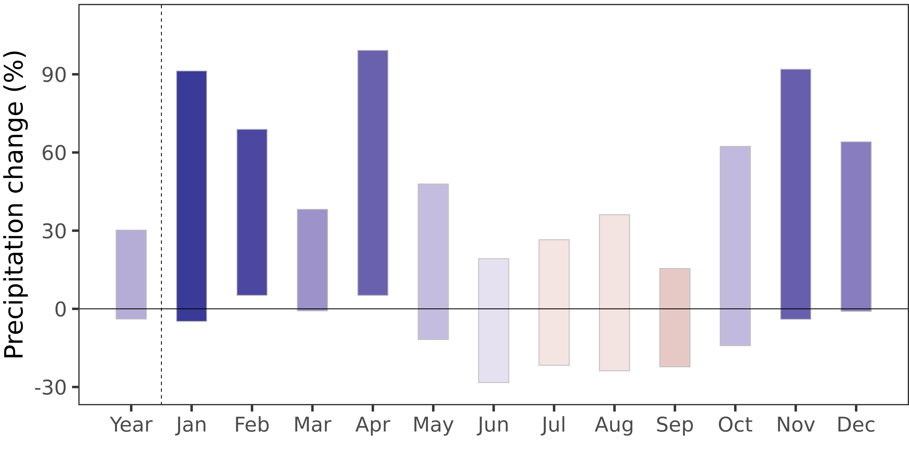
Precipitation Projections – Example of Gjovic
Workshop II: Gjovik – Climate vulnerability, Impacts and Projections
Precipitation (2071-2100)
Emission scenarios
Climate Models
x
Emission scenarios
Far future:
Similar pattern with high increase in rainfall in all seasons (+35% in Jan) except summer (-4.3% in Aug).
Higher uncertainty
Climate Models
x
Emission scenarios
wet
dry
Data: ISIMIP 3b

Slide 13

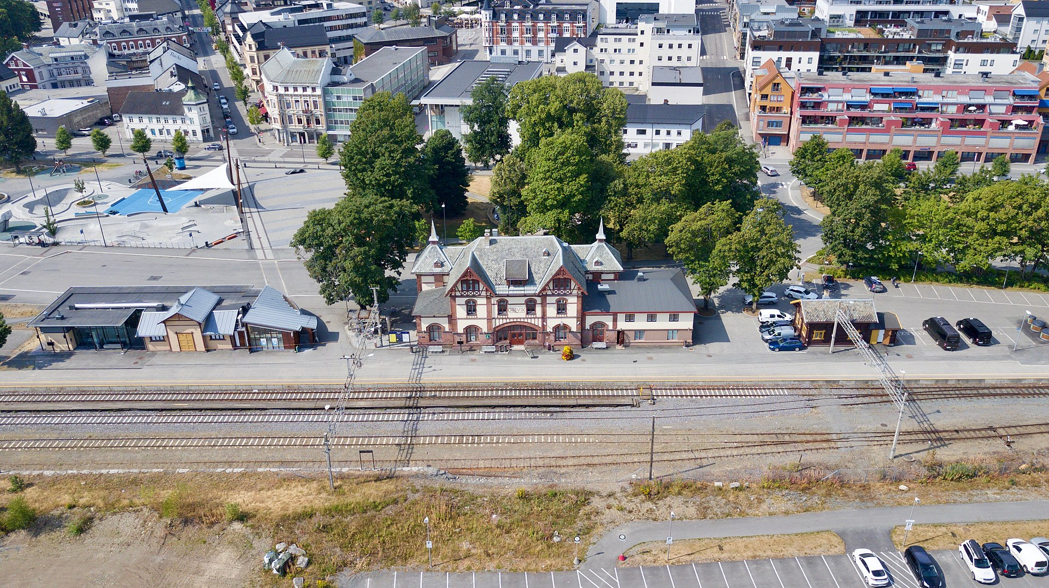
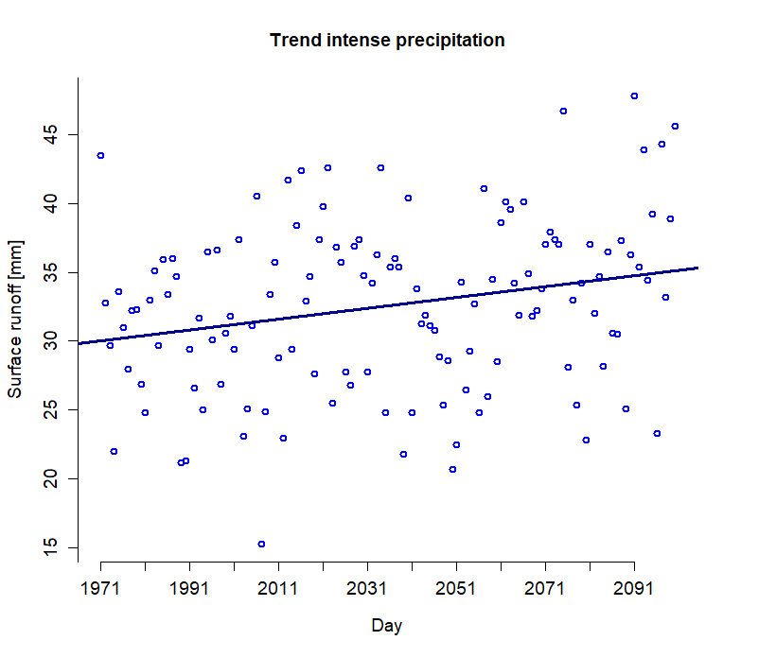
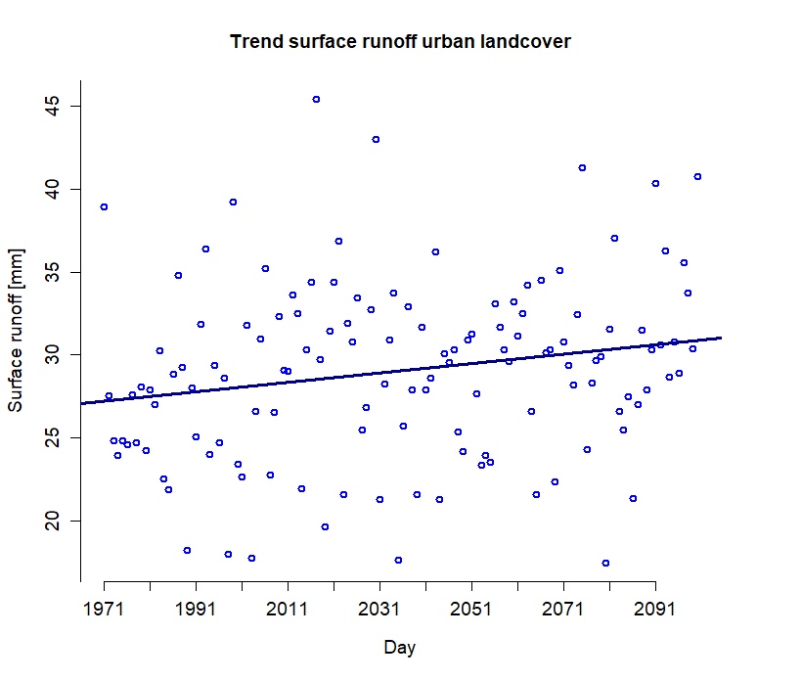
Trend in intense precipitation and surface runoff under high-end climate change conditions – Example 1
Trend increase in precipitation
Trend increase in surface runoff

Slide 14
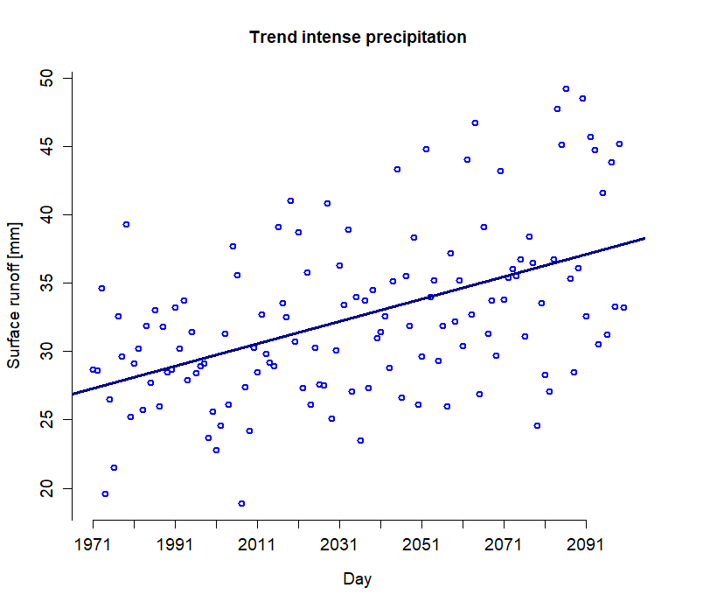
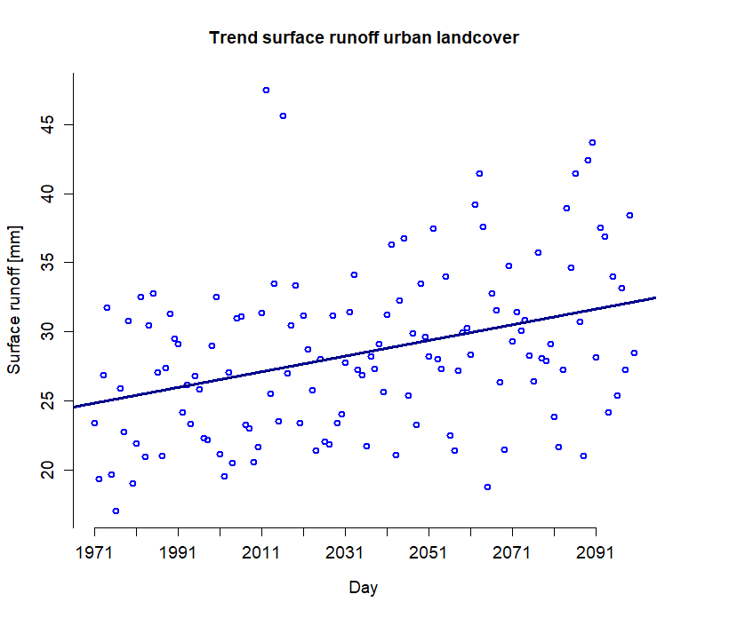
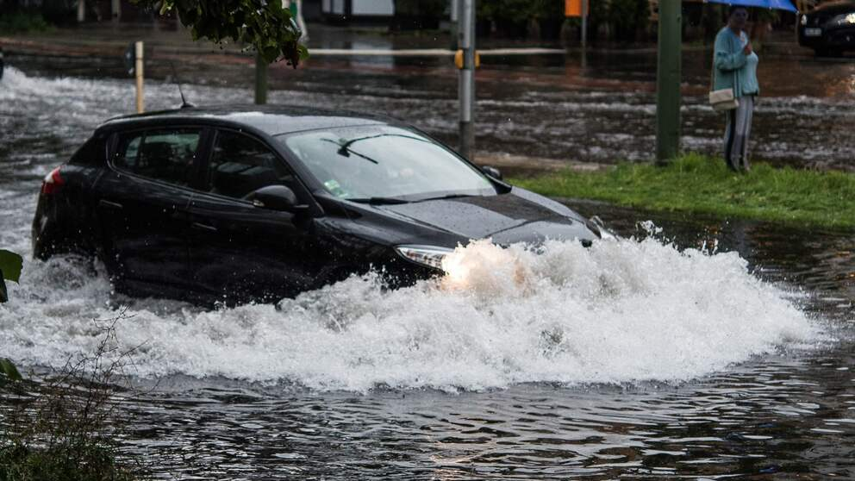
Trend in intense precipitation and surface runoff under high-end climate change conditions – Example 1
Trend increase in precipitation
Trend increase in surface runoff

Slide 15
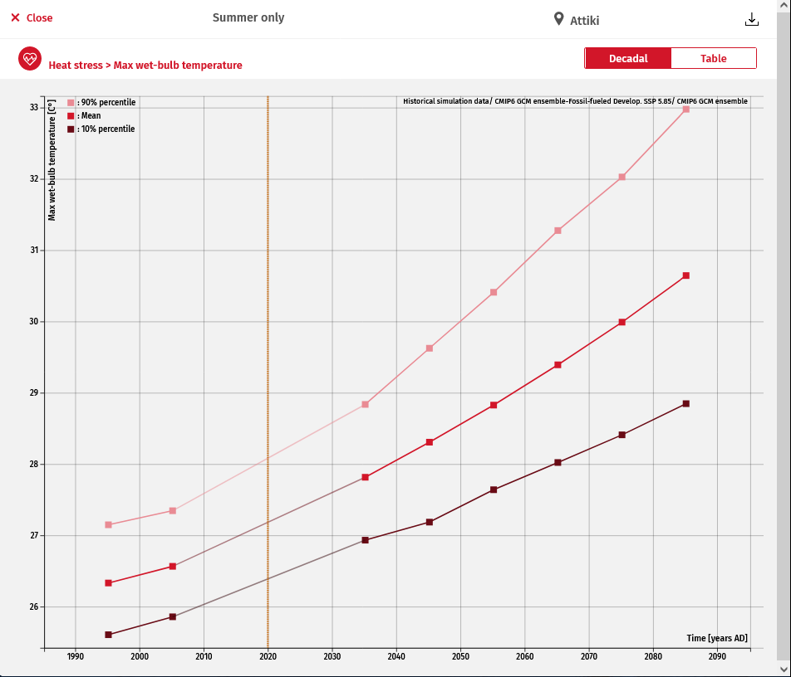
Health and heat
Workshop II: Egaleo – Climate vulnerability, Impacts and Projections
Health: Wet Bulb Globe Temperature
Wet Bulb Globe Temperature (WBGT) is a measurement used to assess the risk of heat related illnessess due to exposure to the current temperature, humidity, wind speed and solar radiation parameters.
Max WBGT corresponds to the daily maximum values of WBGT.
< 25.6°C - 27.7°C = White: 5 min rest every 30 min
27.8°C - 29.4°C = Green: 5 min rest every 25 min
29.5°C - 31°C = Yellow: 5 min rest every 20 min
31.1°C - 32.1°C = Red: 5 min rest every 15 min
> 32.2°C = Black: Suspend athletic activities recommended

Slide 16
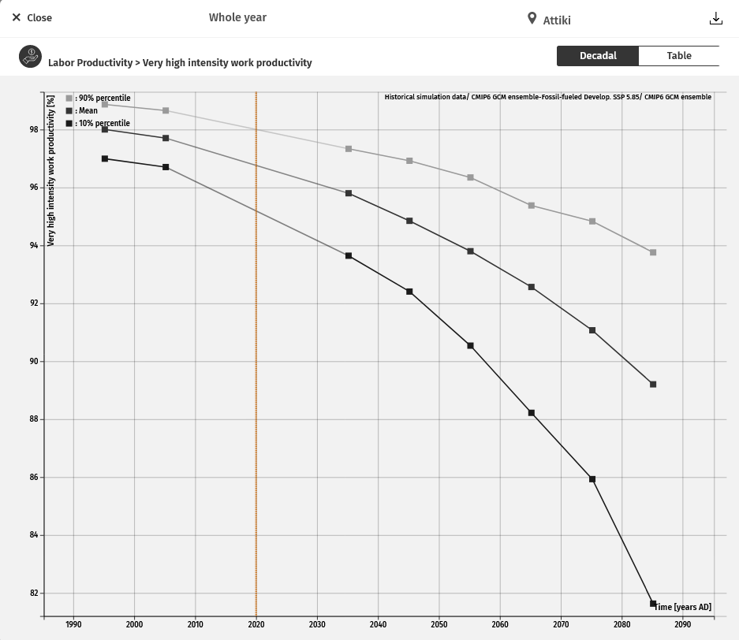
Heat and outdoor productivity
Workshop II: Egaleo – Climate vulnerability, Impacts and Projections
Outdoor productivity
Labor productivity denotes the maximum potential work output achievable by an individual in a day. This measure is represented as a percentage (%) to indicate the proportion of work that can be achieved under current climatic conditions. It is mainly derived from the impact of heat on productivity, as exposure to heat stress tends to diminish the average worker's capacity to perform tasks efficiently.
There are 4 different levels of labor productivity levels, each corresponding to a certain amount of work intensity:
200W = Low intensity work
300W = Medium intensity work
400W = High intensity work
500W = Very high intensity work

Slide 17
Projected climate changes for Gjovik relative to 1991-2020
Workshop II: Gjovik – Climate vulnerability, Impacts and Projections
Heat stress
 | 2021-2050 | 2031-2060 | 2071-2100
summer days (Tmax > 25 °C): | +103% (17 – 180%) | +146% (21–300%) | 366% (36 –1267%)
frost days (Tmin < 0 °C) | -12% (-26 – -6%) | -15% (-36 – -4%) | -28% (-70 – 6%)
icing days (Tmax < 0 °C) | -14% (-29 – -7%) | -19% (-39 – -4%) | -32% (-83 – 8%)
warm spells (at least 6 consecutive days with very high temperatures) | 185% (73 – 473%) | 231% (116 – 753%) | 548% (661 – 1695%)
cold spells (at least 6 consecutive days with very low temperatures) | -62% (-92 – 50%) | -69% (-96 – 0%) | -86% (-100 – -19%)
Data: ISIMIP 3b

Slide 18






Summary – Example of Gjovic
Workshop II: Gjovik – Climate vulnerability, Impacts and Projections
According to projections, Gjovik is likely to deal with
>
Milder winters
The increase of average temperatures will depend on emissions
Wetter Winters but with less snow
Overall precipitation increase

Slide 19
Outline
Outline
Introduction
Fast-track information on climate change and impacts streamlined to the demonstrators
Advanced climate scenario data and bio-physical modelling implementation
Web portal for data and information
Conclusions and outlook

Slide 20
Advanced model set-up
Advanced model set-up
IMAGE
Multisite, multivariate stochastic weather generator
CaMa Flood
Hydraulic model
BN-FLEMOps
Probabilistic flood loss model
SWIM
Hydrological model
CORDEX-EU
Imperial College London
PIK Potsdam
PIK Potsdam
GFZ Potsdam
  GCM-RCM climate model simulations

Slide 21
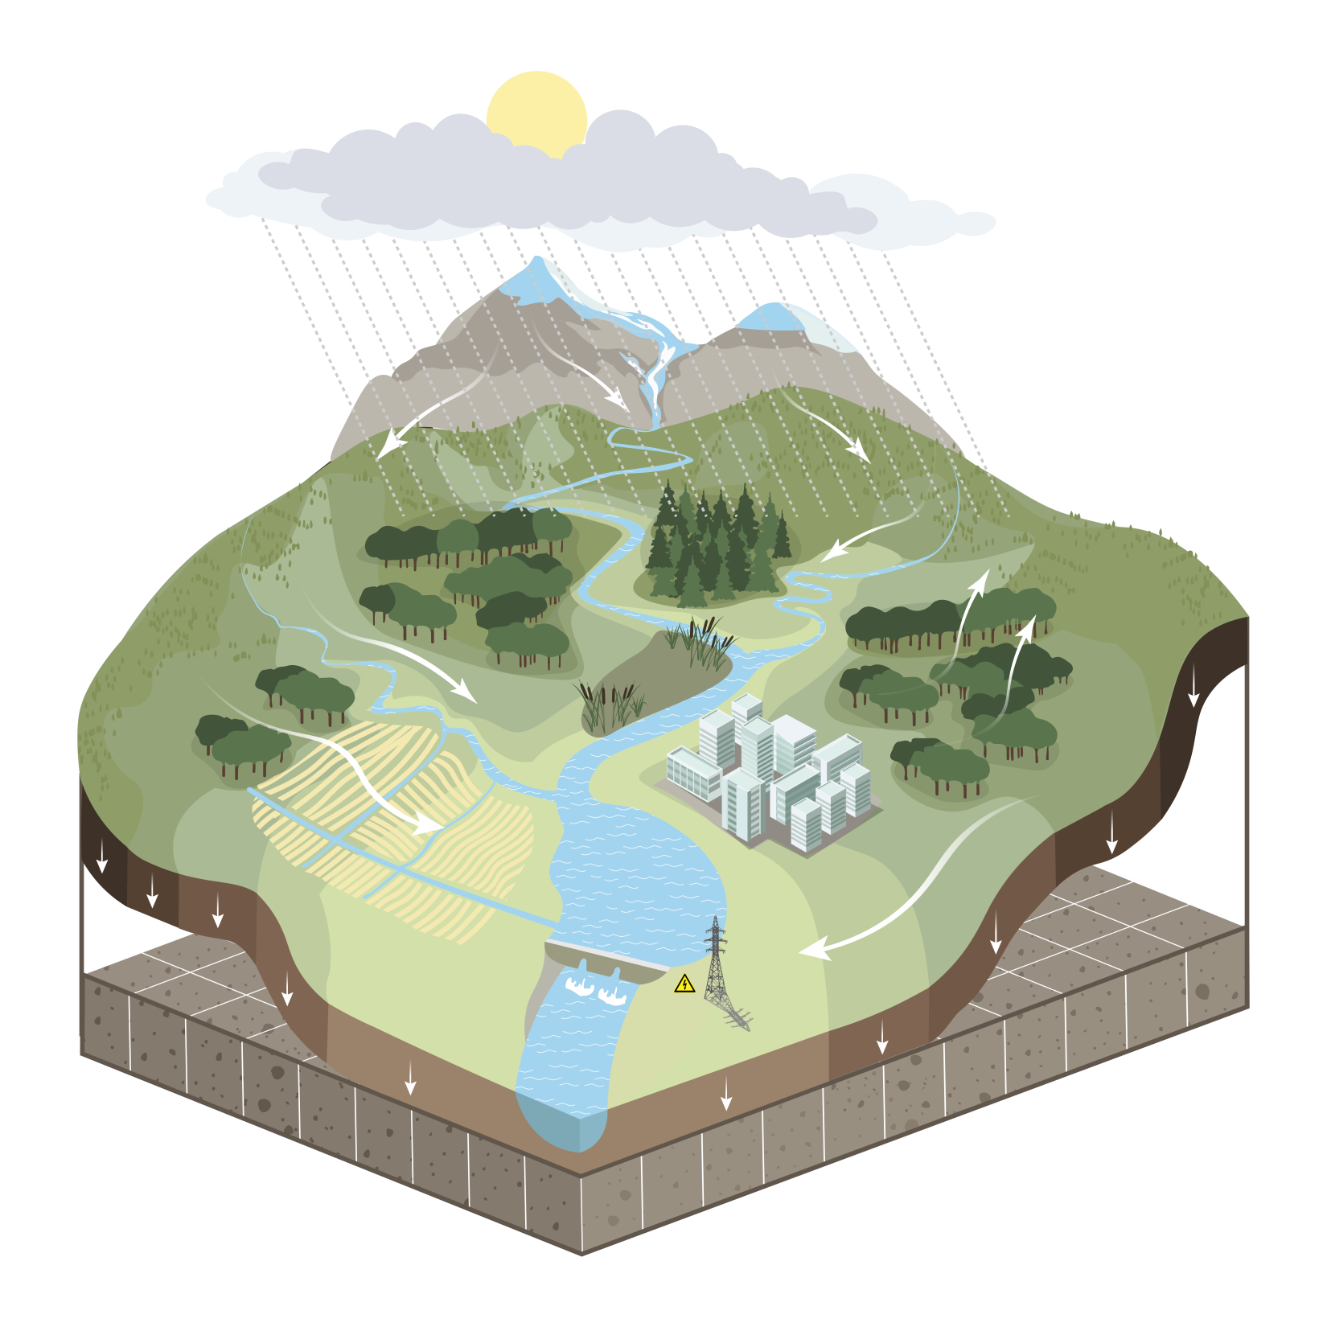
Eco-hydrological model SWIM
Natural processes
Weather / climate (input)
  Precipitation (rain & snow)
  Temperature, solar radiation, rel. humidity
Hydrology
  Infiltration
  Runoff: surface, sub-surface, groundwater
  River discharge
  Evapotranspiration
Vegetation
  Natural: forests, grasslands, savannah...
  Managed crops
Glaciers

Slide 22
Eco-hydrological model
Water and land management
Crop management
  Crop rotations
  Fertilization
Irrigation
  Crop water demand / deficits
  Water use efficiency
Water allocation
Reservoirs
  Hydropower
  Flood protection
  Water supply

Slide 23
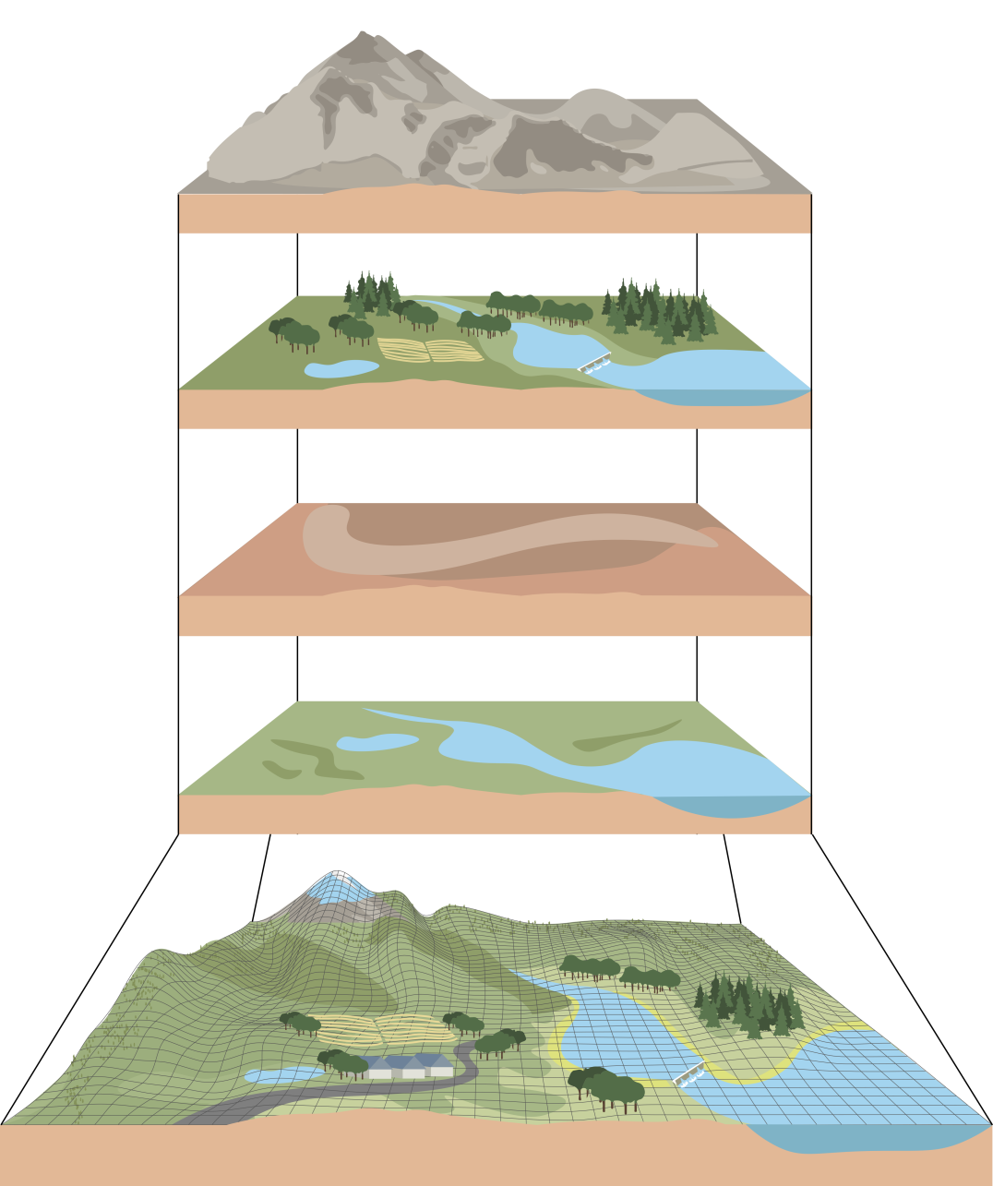
Spatial data
Basic GIS layers
Elevation, slope (DEM)
European Soil Map
CORINE land use map
Digital Elevation Model of 100 m resolution
Climate data of European Weather Service
ISIMIP climate scenario data
Land use / cover (LULC)
Natural, managed
Soils
Climate input
Other
Reservoirs, irrigation,
wetlands, glaciers, elevation
Hydrotopes (HRUs)

Slide 24
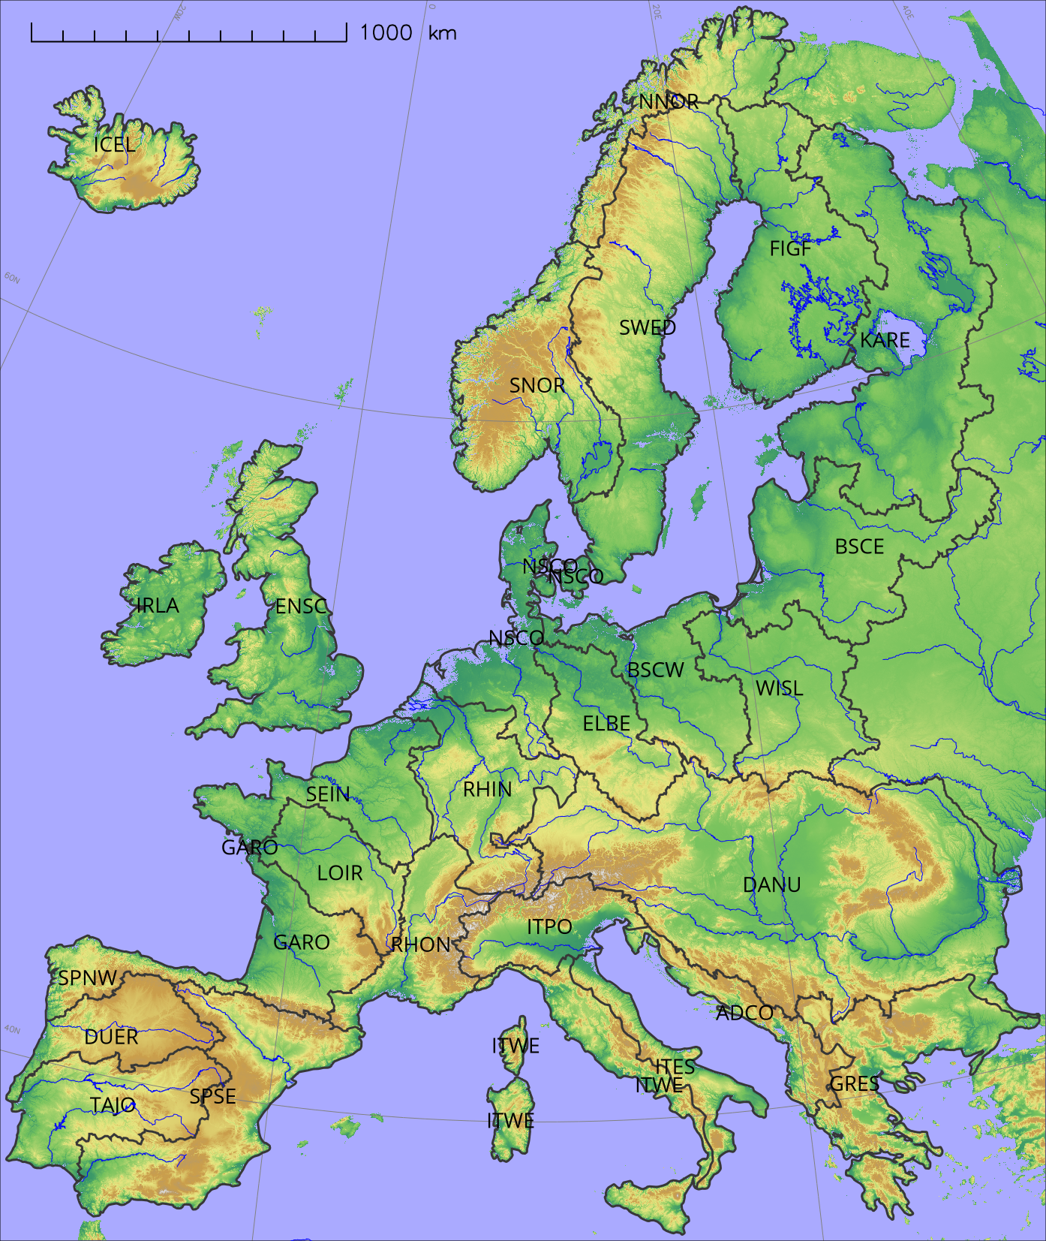
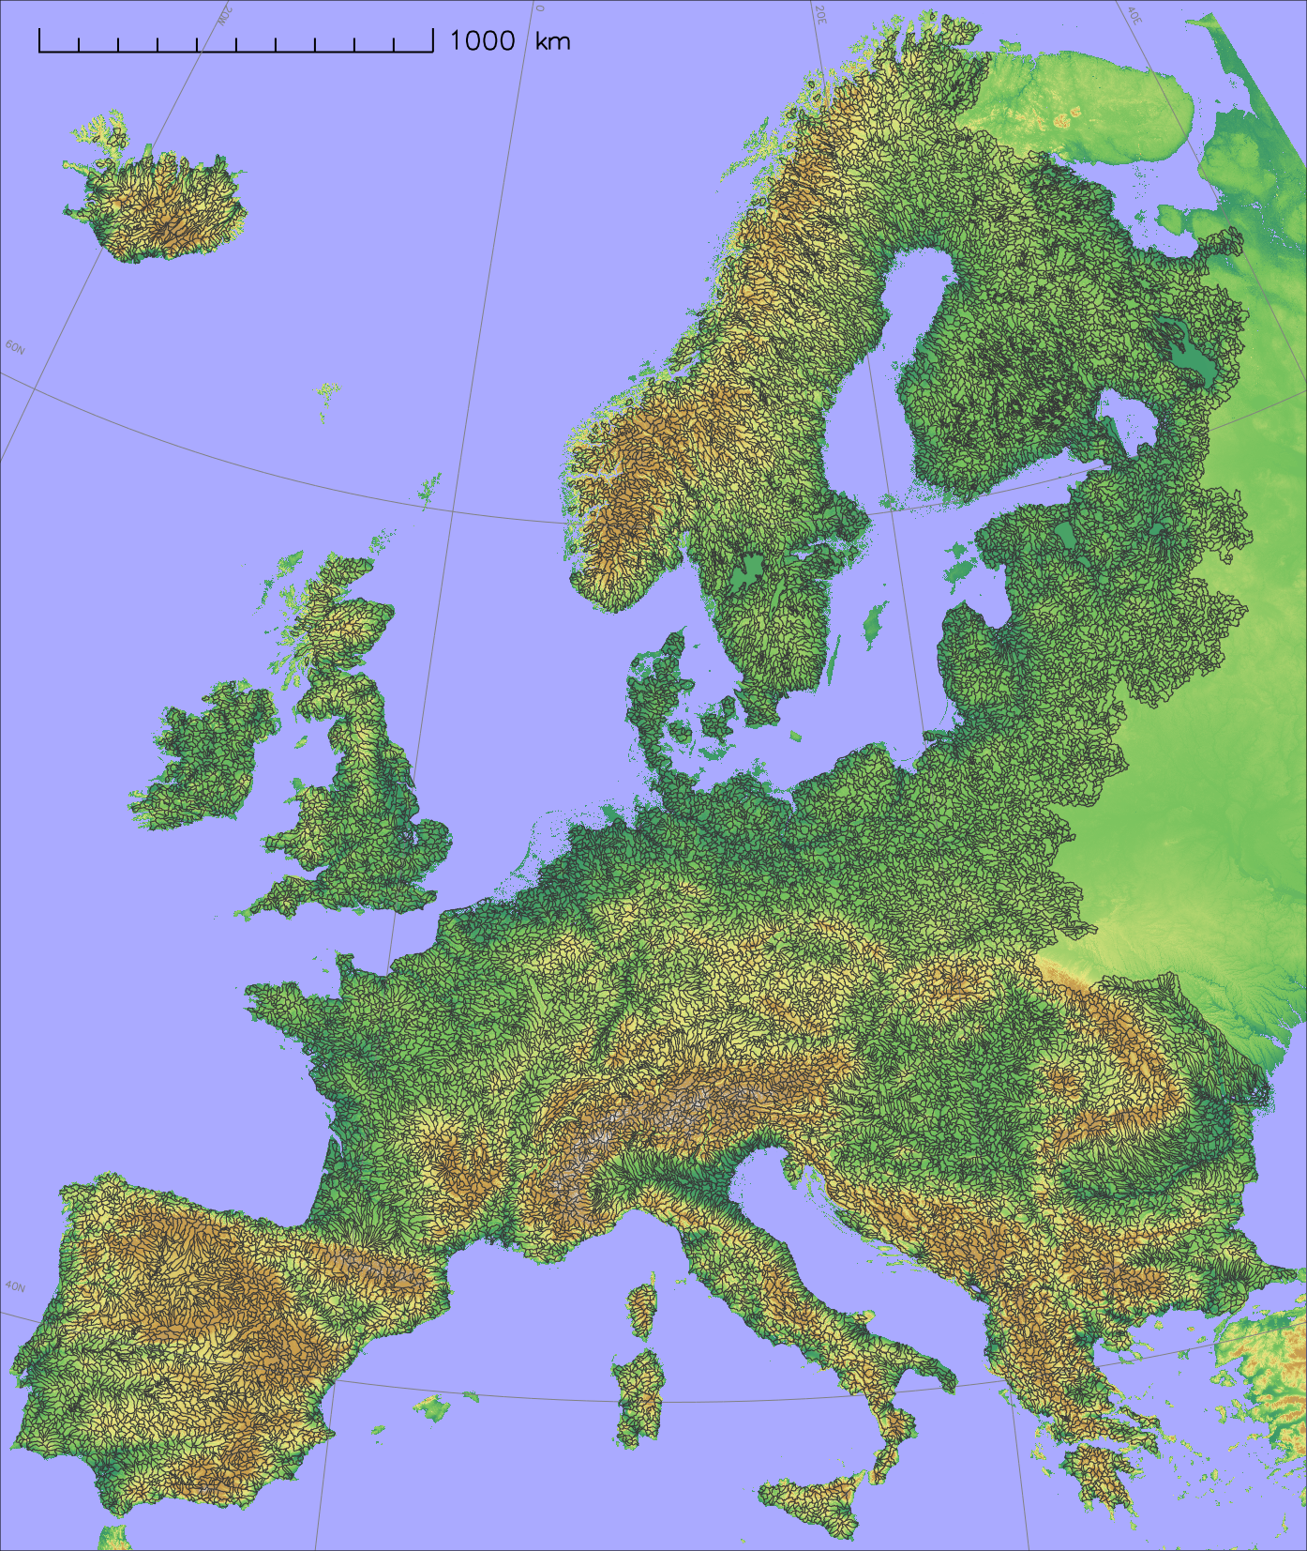
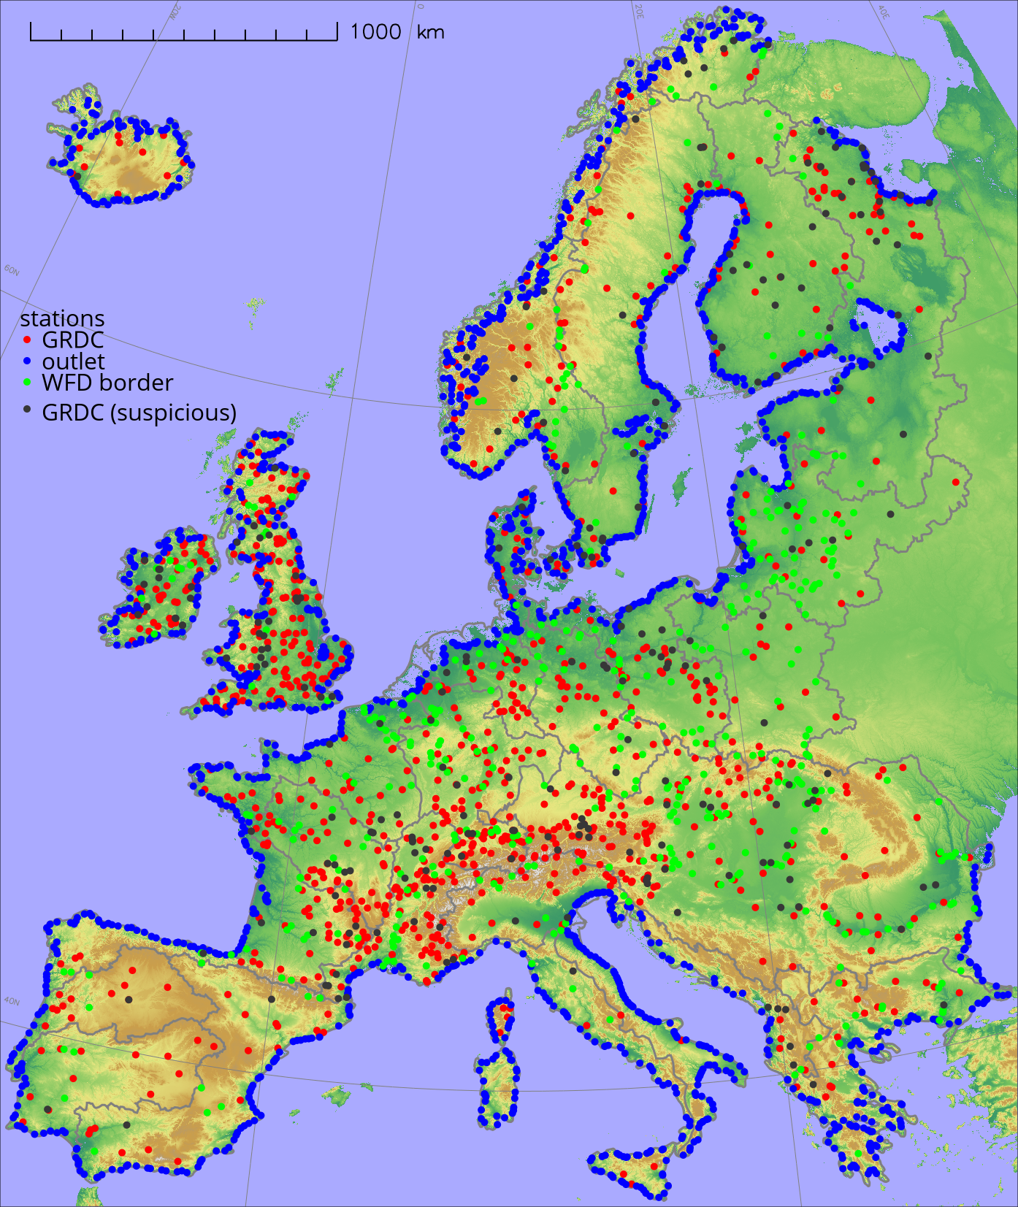
Model implementation
28 River regions
Divided into 3100 subbasins
~ 1200 Gauge stations

Slide 25
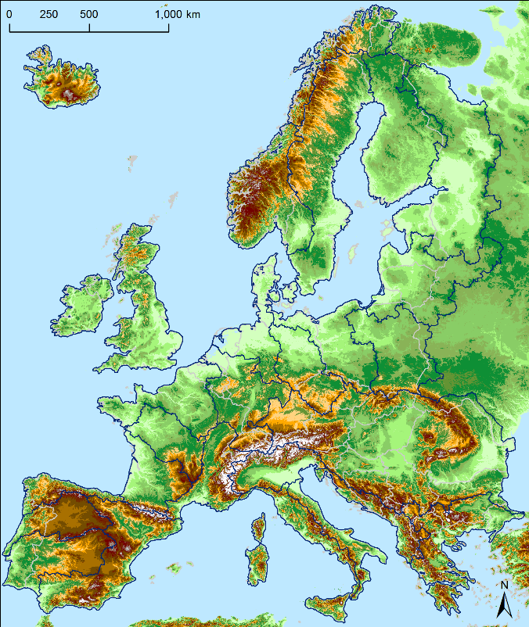
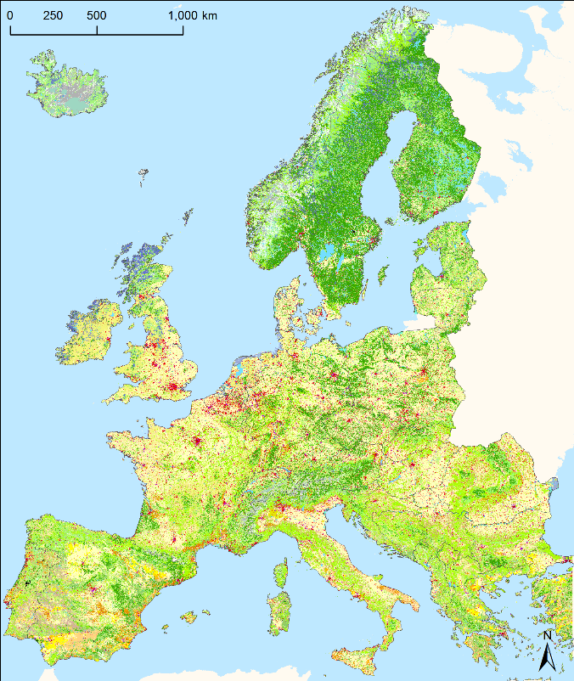
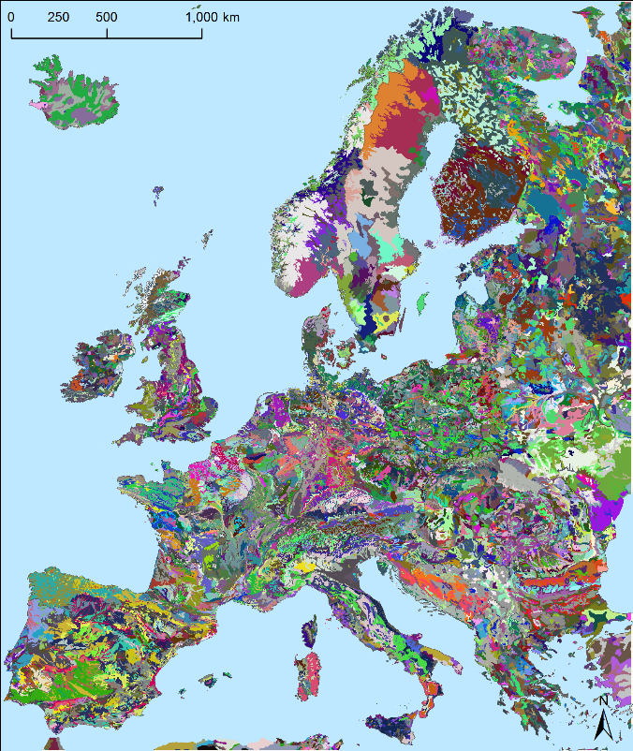
Model implementation
DEM 100 m
Land us CORINE 2020
European Soil Map

Slide 26
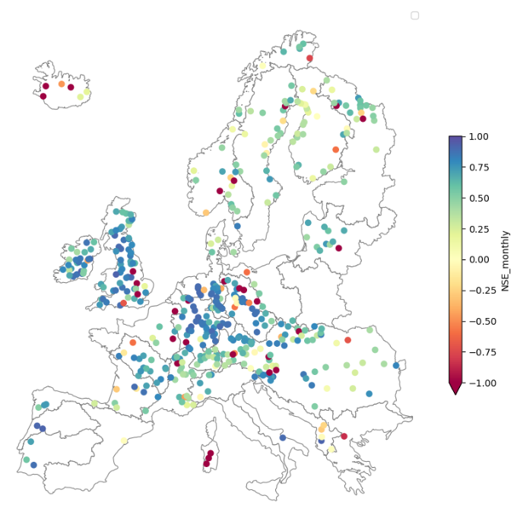
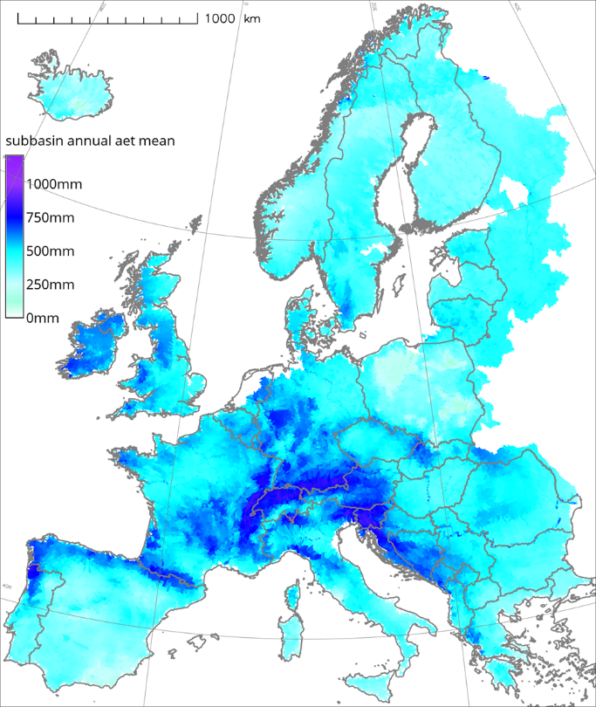
Model implementation
Statistical results
> 0.5 is “good”
Model result
evapotranspiration

Slide 27
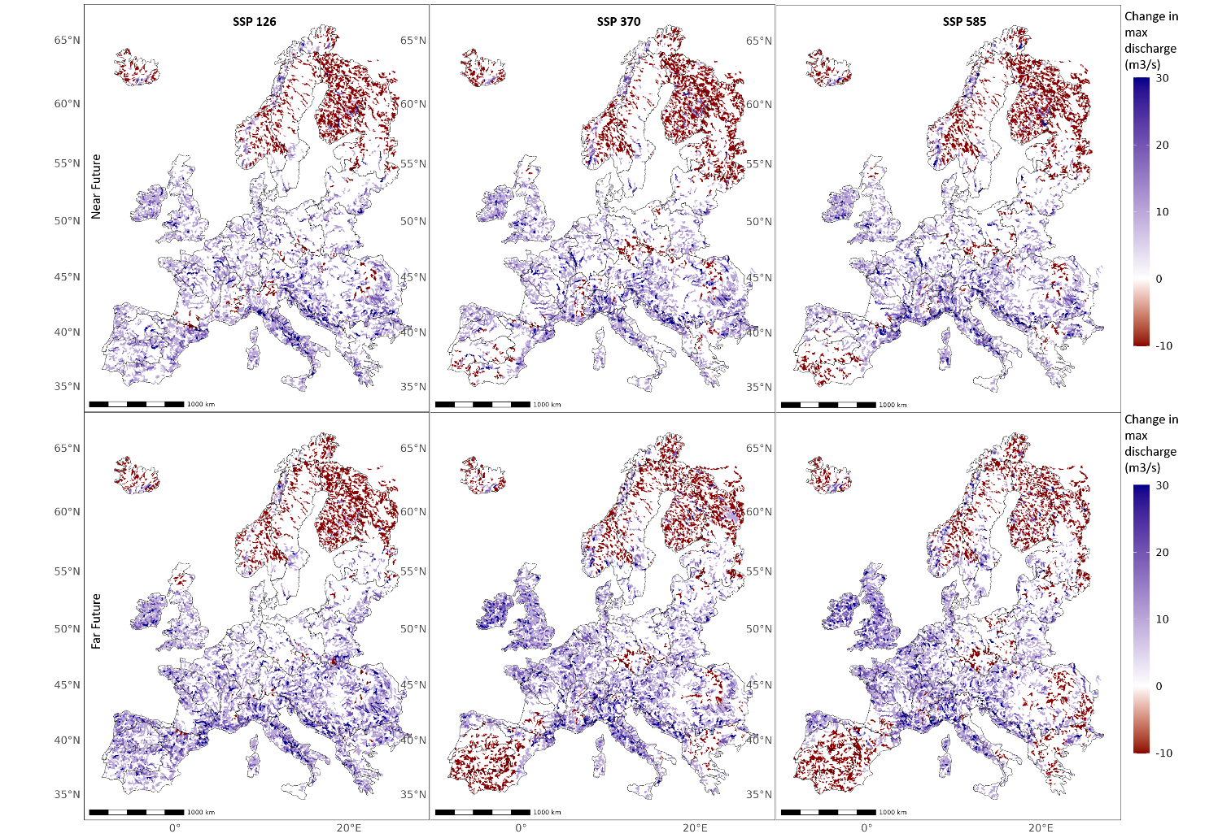
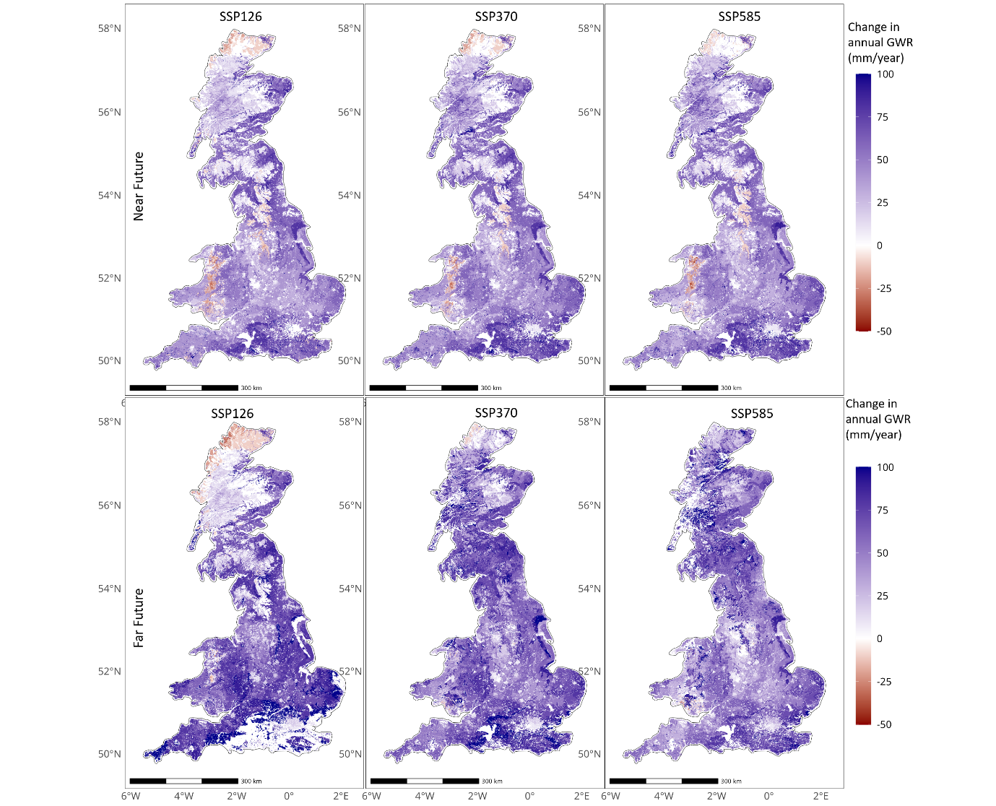
Model results
Model result
change in annual max flow
Model result
change in annual GWR

Slide 28
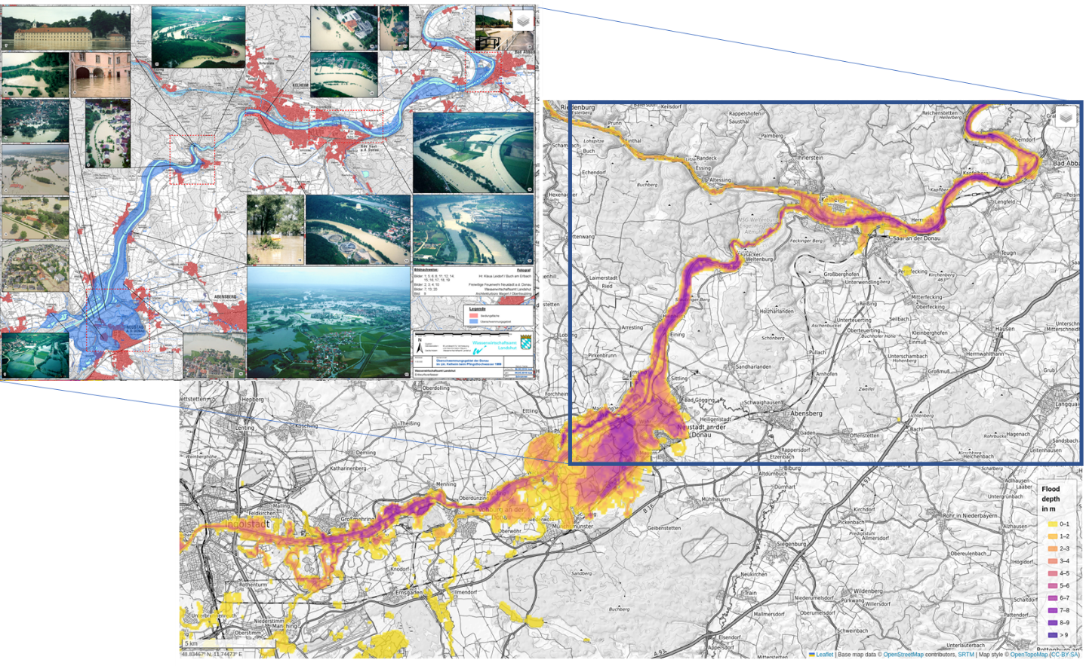
Model result CaMa-Flood
Observed and simulated inundation

Slide 29
West Country
Impacts on water availability, vegetation and extremes

Slide 30
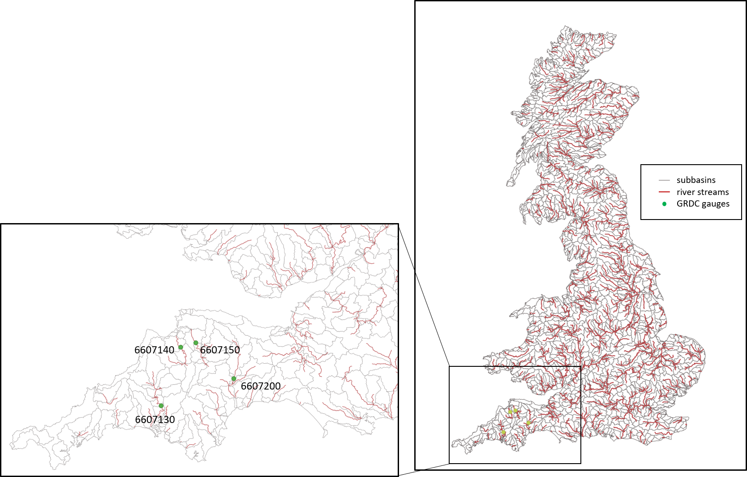
Example: West Country
No of catchments: 344
No of subbasins: 1630
No of hydrotopes: 47948
No. of discharge station: 167

Slide 31
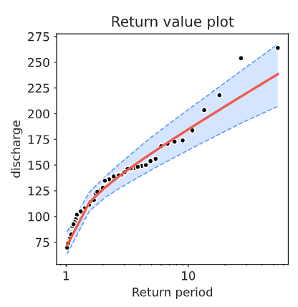
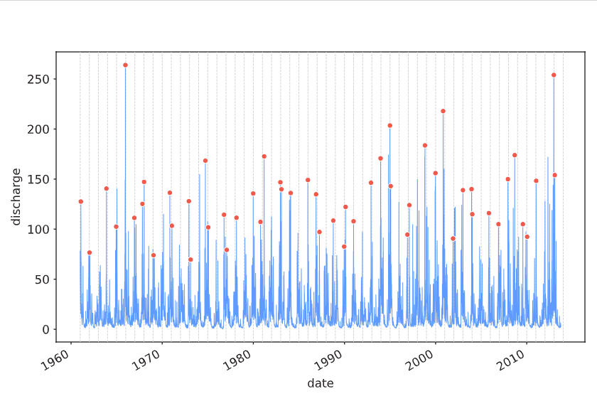
First step: Investigation of observed discharge (River Exe)
Observed discharge and extremes (River Exe)
Flood
statistics
Daily discharge River Exe [m³/s]
Return period [a] Discharge [m³/s]
5 161.5
10 184.8
25 214.2
50 236.0
100 257.7
250 286.2

Slide 32
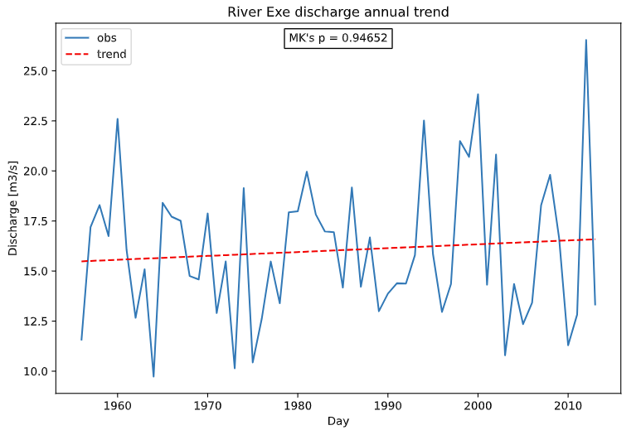
River Exe, development of river discharge
Trend in annual discharge (River Exe)

Slide 33
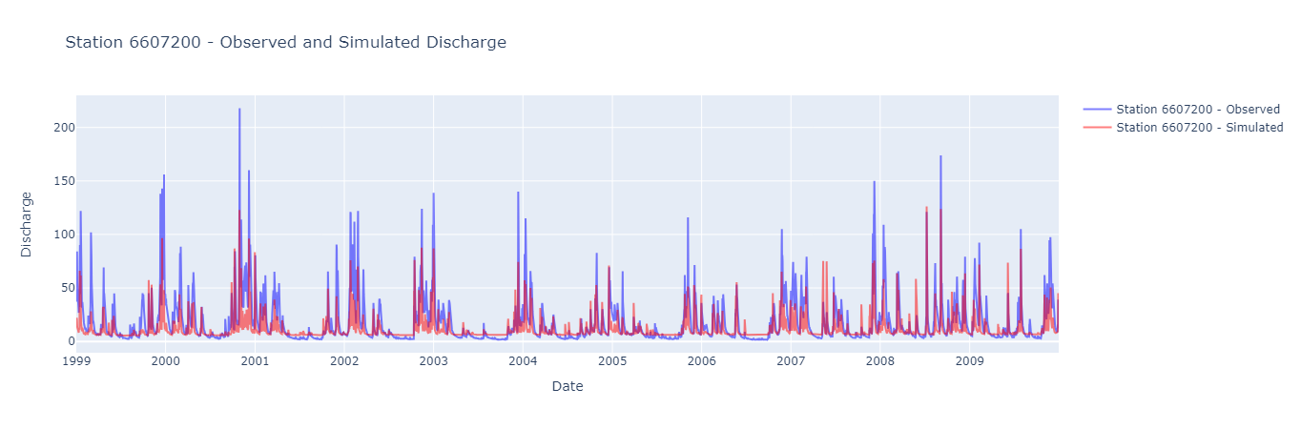
Comparison of observed and modeled discharge
Workshop II: Westcountry – Climate vulnerability, Impacts and Projections
SWIM was applied for 344 river catchments in GB, including 4 located in Westcountry:
River Tamar
River Torridge
River Taw
River Exe
(Global multi-goal calibration using observed discharge at XYZ stations and sattelite ET data)
Example: River Exe –
modelled and observed discharge [m³/s]

Slide 34
Projected annual and seasonal discharge (River Exe)
Workshop II: Westcountry – Climate vulnerability, Impacts and Projections
Development of annual discharge until end of the century (River Exe)

Slide 35
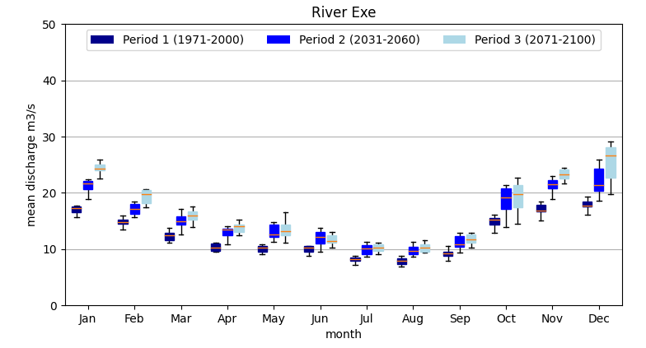
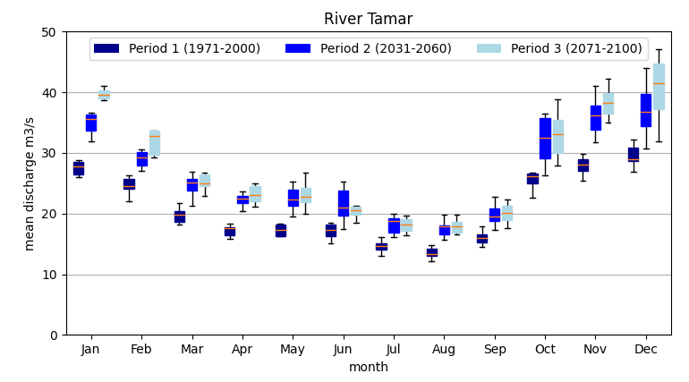
Projected annual and seasonal discharge (River Exe)
Workshop II: Westcountry – Climate vulnerability, Impacts and Projections
Development of monthly discharge (River Exe)
Development of monthly discharge (River Tamar)

Slide 36
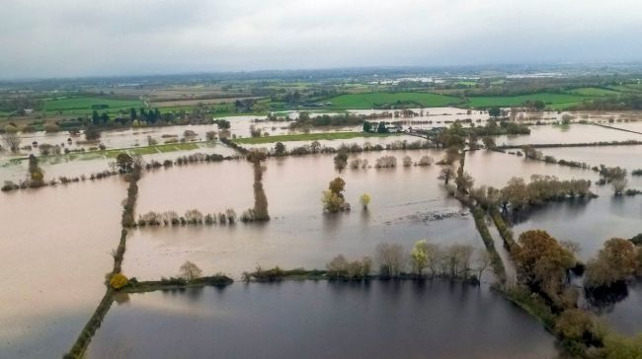
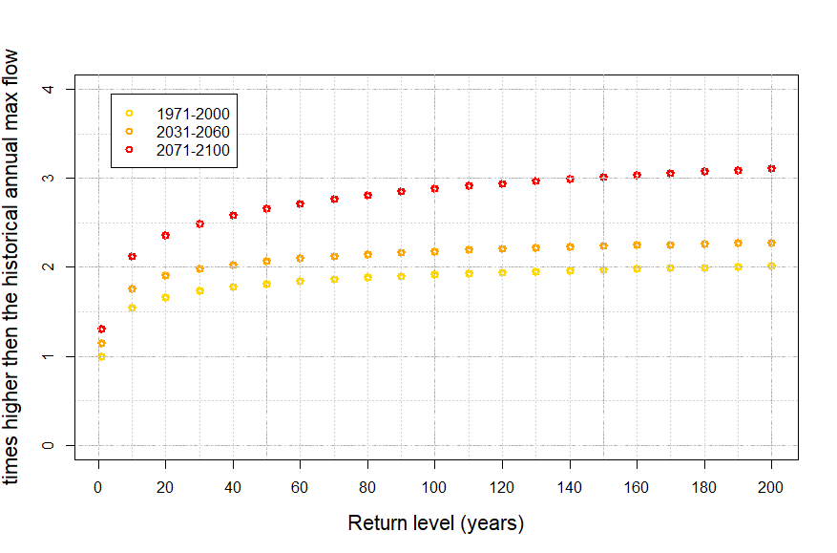
Development of flood hazard – hot scenario
Workshop II: Westcountry – Climate vulnerability, Impacts and Projections
Projected changes in flood hazard (River Exe) – hot scenario RCP585
River Exe – change in flood return levels high end scenario
More
often
Strong increase in flood risk mid – end of century
More

Slide 37
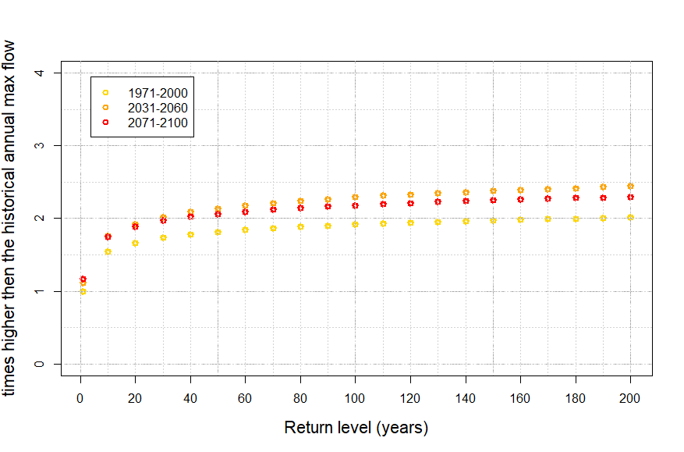
Development of flood hazard – green scenario
Workshop II: Westcountry – Climate vulnerability, Impacts and Projections
Projected changes in flood hazard (River Exe) – green scenario RCP126
River Exe – change in flood return levels low-end scenario
River Exe – change in flood return levels high end scenario
After increase until mid of the century a slow decrease in flood hazard

Slide 38
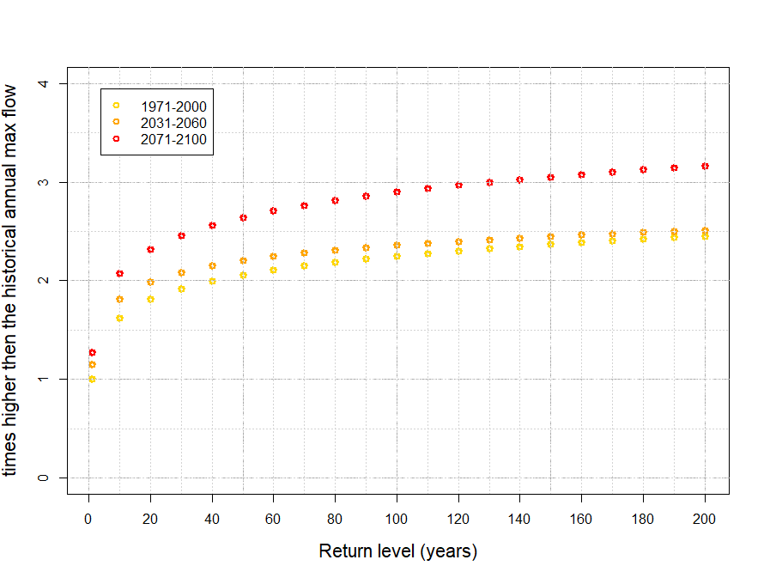
Development of flood hazard – hot scenario
Workshop II: Westcountry – Climate vulnerability, Impacts and Projections
Projected changes in flood hazard (River Tamar) – hot scenario RCP585
River Tamar – change in flood return levels high-end scenario
Strong increase in flood risk mid – end of century

Slide 39
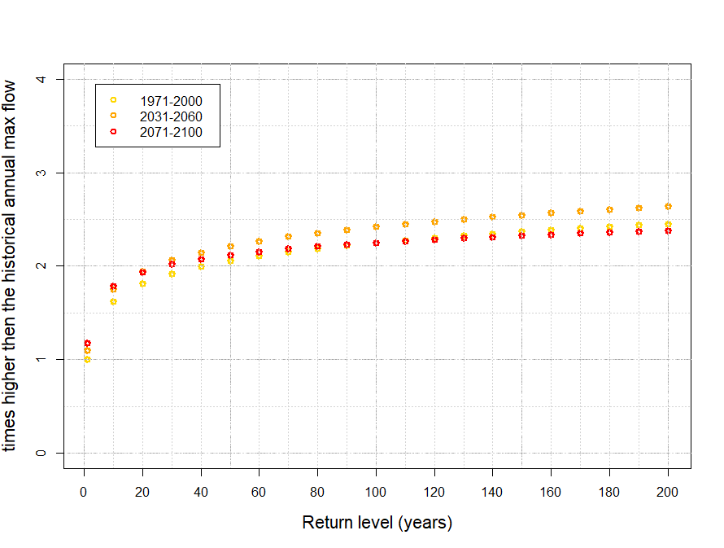
Development of flood hazard – green scenario
Workshop II: Westcountry – Climate vulnerability, Impacts and Projections
Projected changes in flood hazard (River Tamar) – green scenario RCP126
River Tamar – change in flood return levels low-end scenario
After increase until mid of the century a stronger decrease in flood hazard

Slide 40
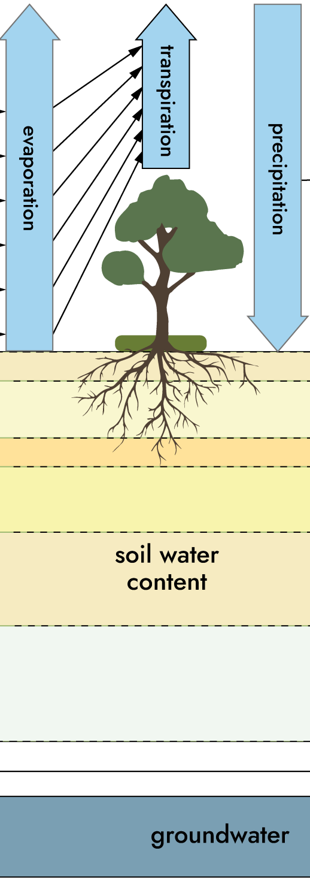
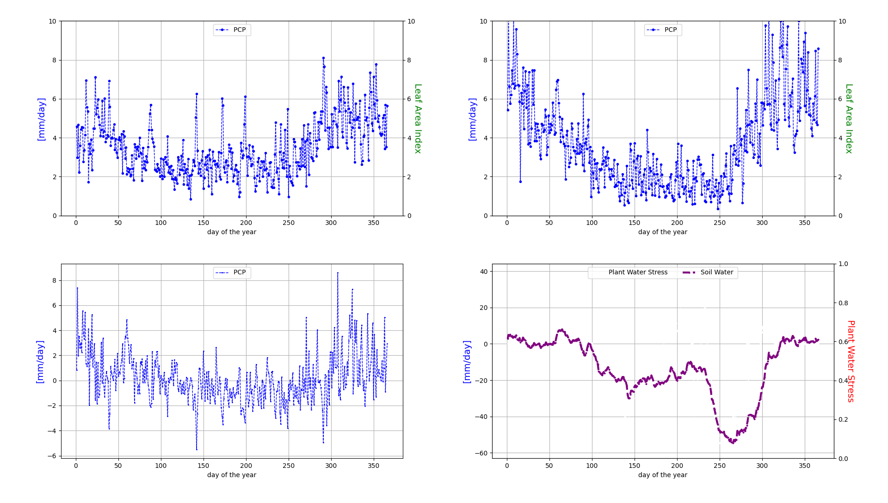
Change in hydrological processes at plot scale
Workshop II: Westcountry – Climate vulnerability, Impacts and Projections
Soil water flows and vegetation growth (arable land)
1971-2000
2071-2100
precipitation

Slide 41
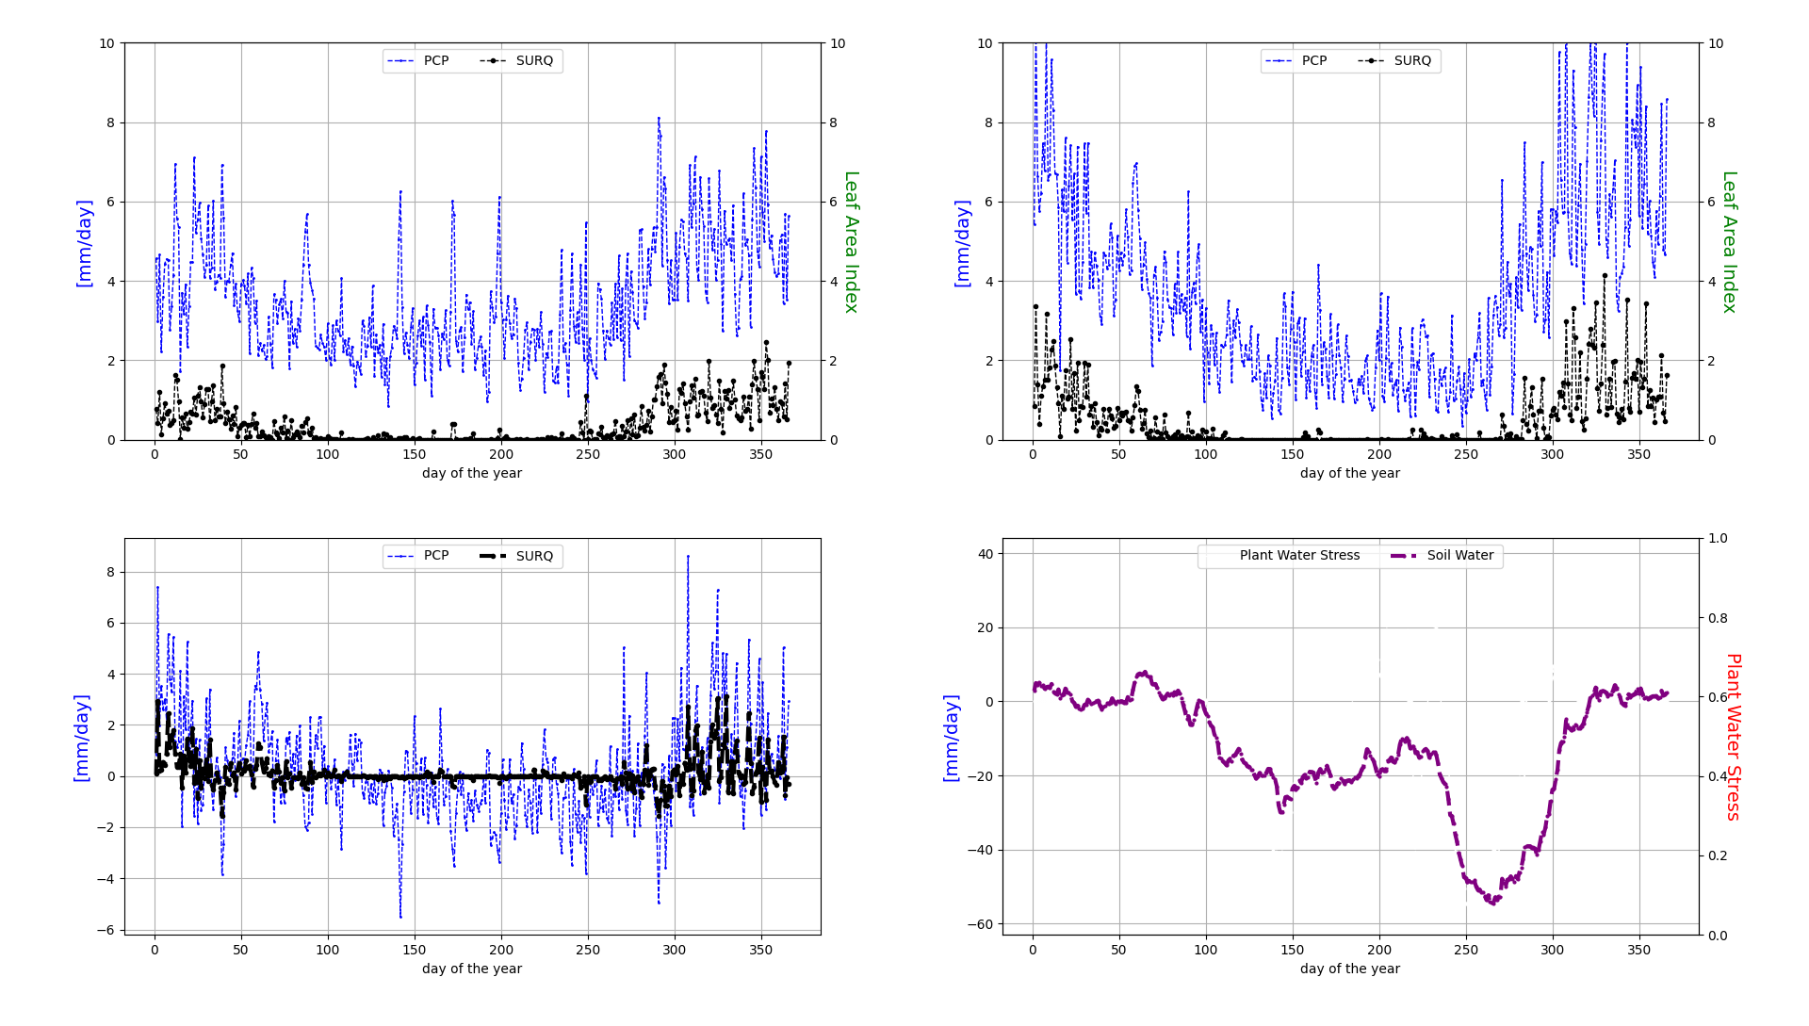
Change in hydrological porcesses at plot scale
Workshop II: Westcountry – Climate vulnerability, Impacts and Projections
Soil water flows and vegetation growth
1971-2000
2071-2100
Surface runoff

Slide 42

Change in hydrological porcesses at plot scale
Workshop II: Westcountry – Climate vulnerability, Impacts and Projections
Soil water flows and vegetation growth
1971-2000
2071-2100
Groundwater recharge

Slide 43
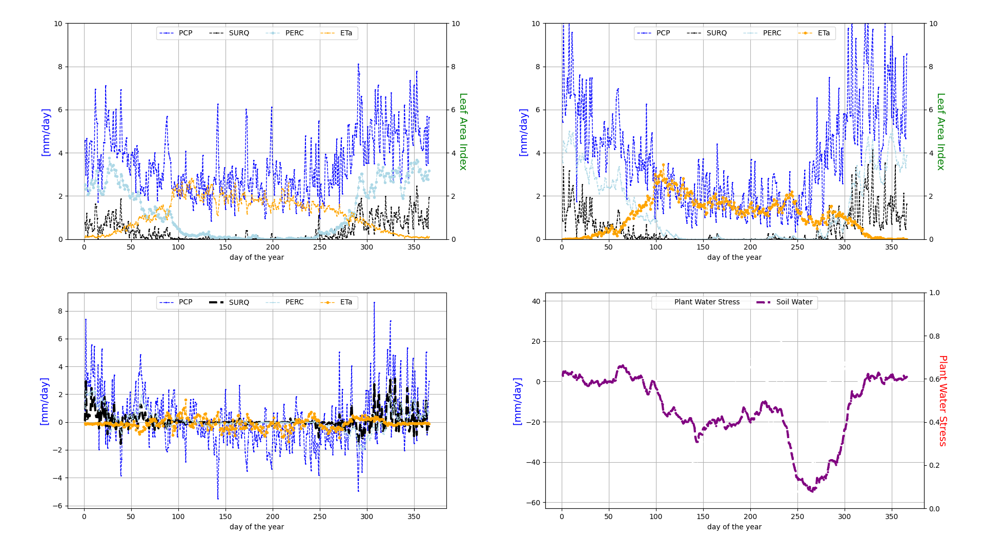
Change in hydrological porcesses at plot scale
Workshop II: Westcountry – Climate vulnerability, Impacts and Projections
Soil water flows and vegetation growth
1971-2000
2071-2100
Evapotranspiration

Slide 44
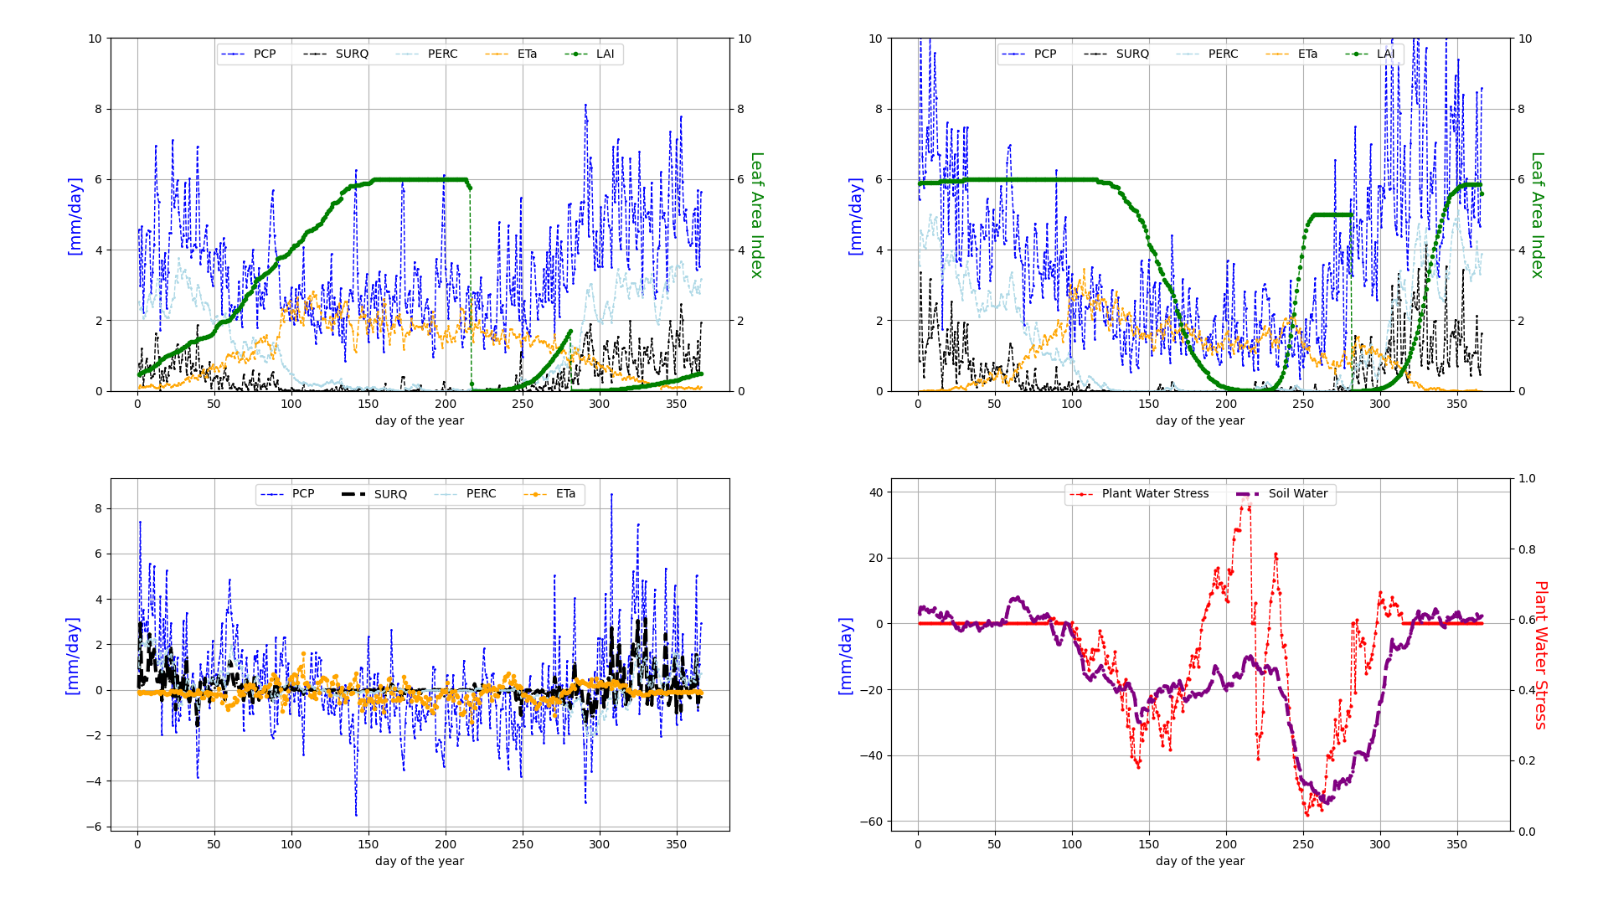
Change in hydrological porcesses at plot scale
Workshop II: Westcountry – Climate vulnerability, Impacts and Projections
Soil water flows and vegetation growth
1971-2000
2071-2100
Leaf Area Index

Slide 45
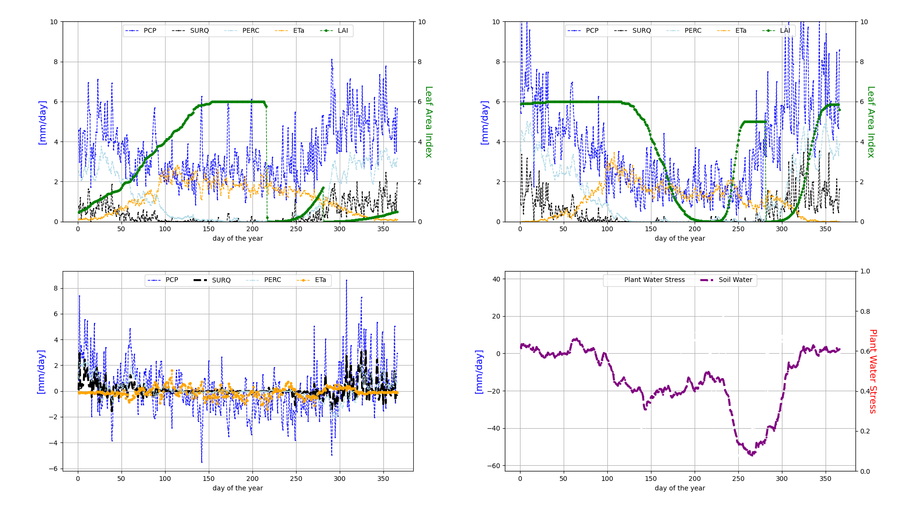
Change in hydrological porcesses at plot scale
Workshop II: Westcountry – Climate vulnerability, Impacts and Projections
Soil water flows and vegetation growth
1971-2000
2071-2100
Leaf Area Index
Soil water

Slide 46
Change in hydrological porcesses at plot scale
Workshop II: Westcountry – Climate vulnerability, Impacts and Projections
Soil water flows and vegetation growth
1971-2000
2071-2100
Leaf Area Index
Soil water
Water stress

Slide 47
Impacts on water quality

Slide 48
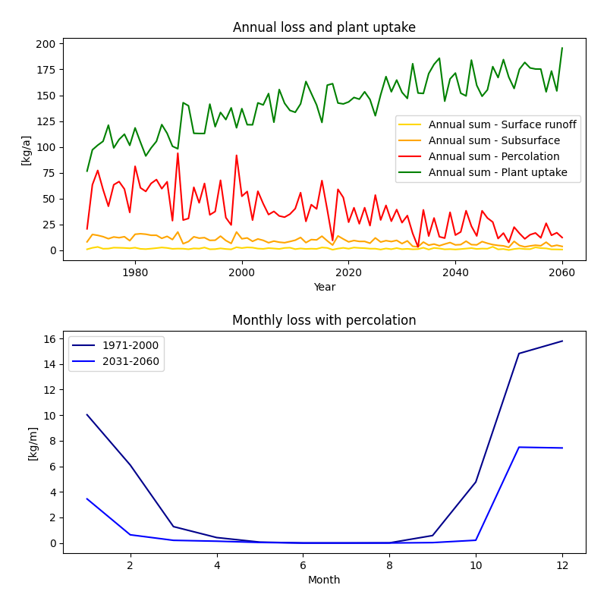
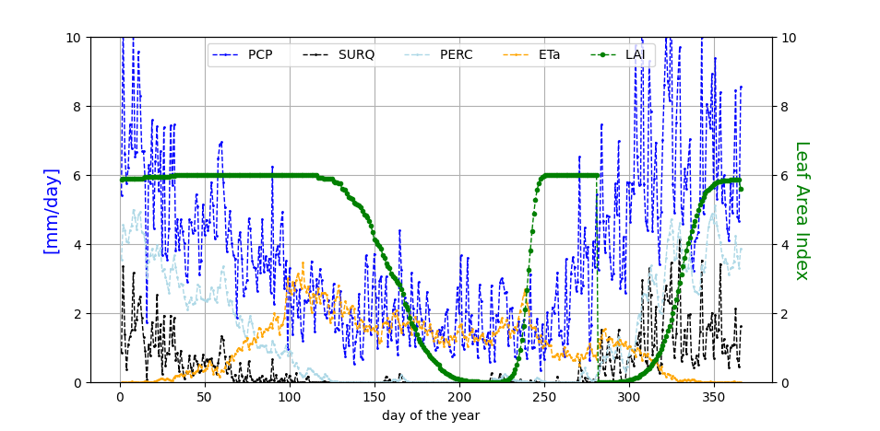
Impacts on water quality
Change in nutrient flows (total nitrogen):
Plant uptake
Very management dependent
Second crop? Fertilizer regime?
Cover crops are relevant
Losses
Past: High losses in winter with percolation

Slide 49
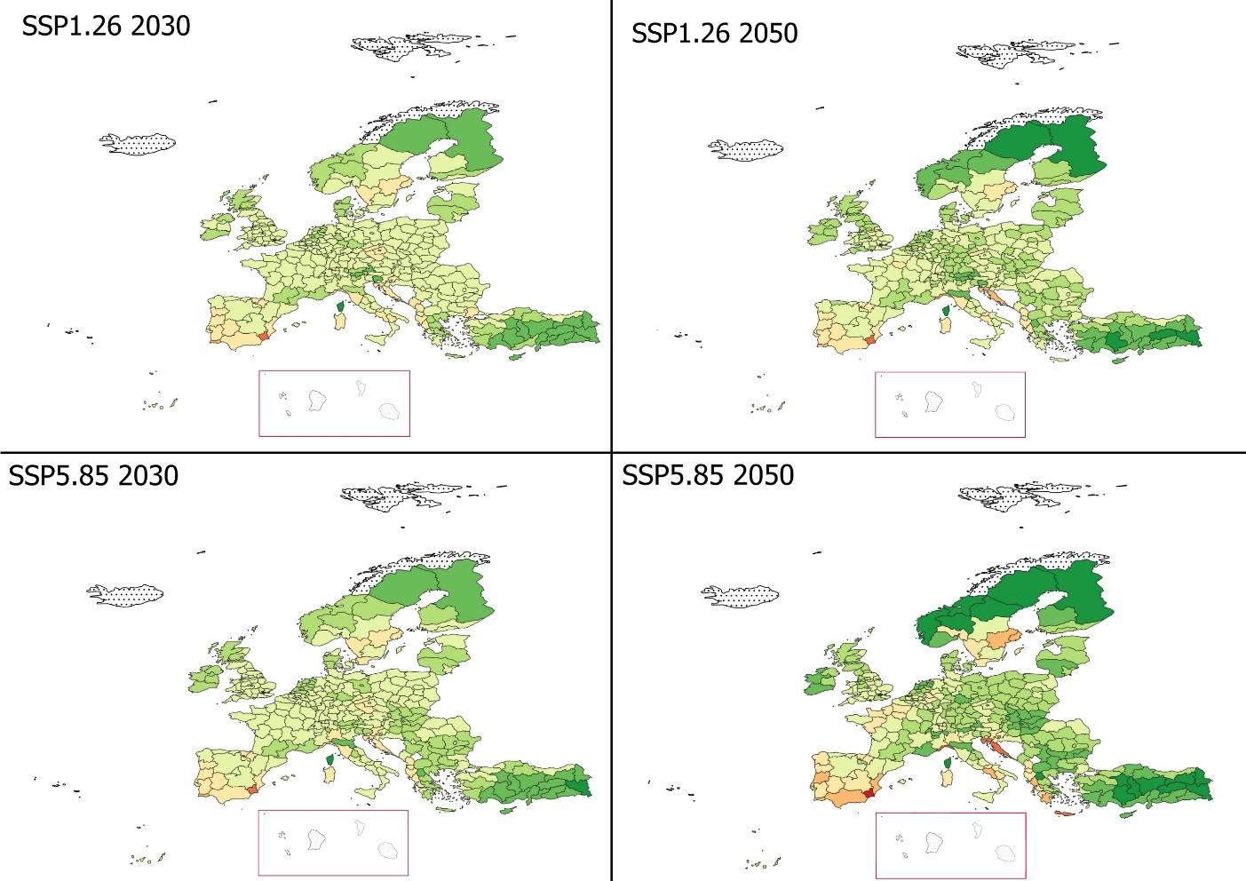
Crop modelling
Cumulative yield change (%) at NUTS2 level in 2030 and 2050 following ssp1.26 and ssp5.85 emission scenarios. The yield change refers to the weighted sum of maize, potato, rice, sorghum, soy and winter wheat yields

Slide 50
Data provision beyond demonstrator process
For example to D2.6:
Groundwater recharge and water yield as indicator for risk for water security
Max annual flood as an indicator for flood risk
Climatic Water Balance as an indicator for drought risk
Wet Bulb Globe Temperature as indicator for health risk
Outdoor productivity and crop yields as one indicator for economical risk
Many other (temperature, precipitation etc)
All converted to Nuts2

Slide 51
Outline
Outline
Introduction
Fast-track information on climate change and impacts streamlined to the demonstrators
Advanced climate scenario data and bio-physical modelling implementation
Web portal for data and information
Conclusions and outlook

Slide 52
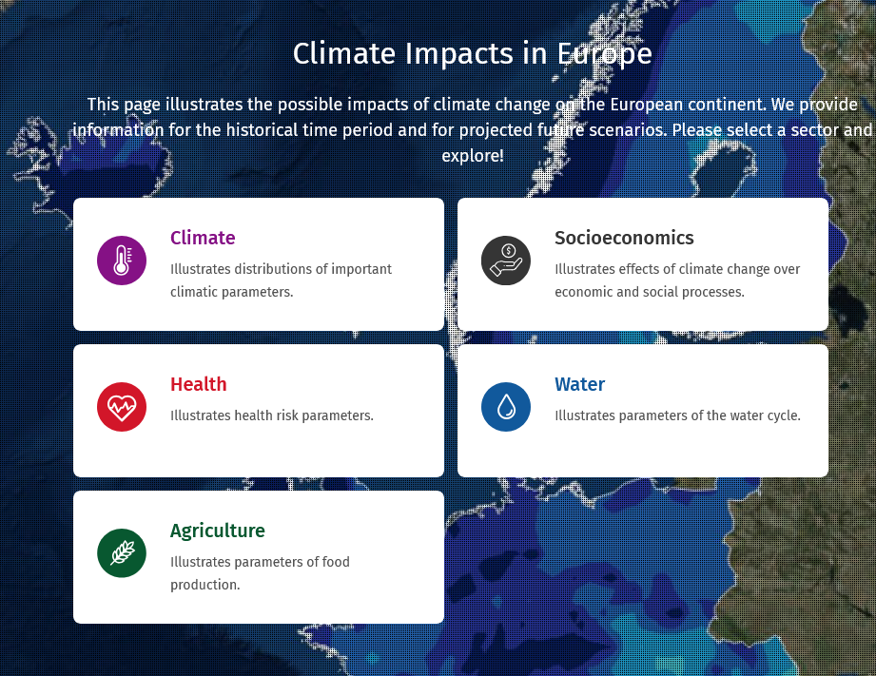

Web portal for data and information
https://kfo.pik-potsdam.de/eur/index_en.html?language_id=en
https://kfo.pik-potsdam.de/eur/index_en.html?language_id=en

Slide 53
Summary
Fast-track information on climate change and impacts streamlined to the demonstrators
Ready
Advanced climate scenario data and bio-physical modelling implementation
Far but ongoing
Web portal for data and information
Version 1 ready but ongoing

Slide 54
Thanks!
Any questions?

